Slide 1

Content area 7: Digital environments
T Level Technical Qualification in Digital software Development: 7-1-2 Understand the features and use of different types of hardware devices
V3.1-1-060625
Presentation by Derek Condon MSc, MBCS, MIET

Slide 2
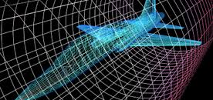
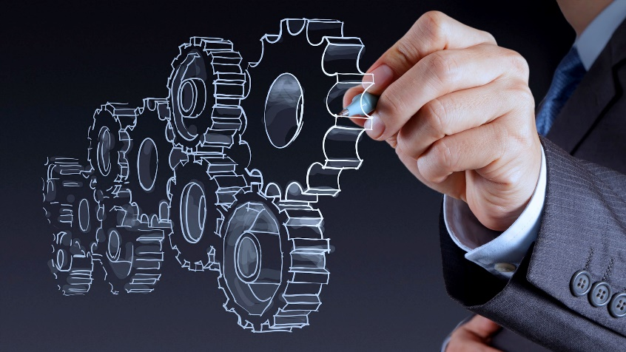
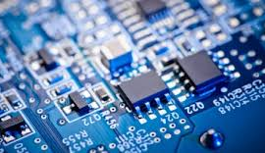
Starter
To get you in the mood

Slide 3
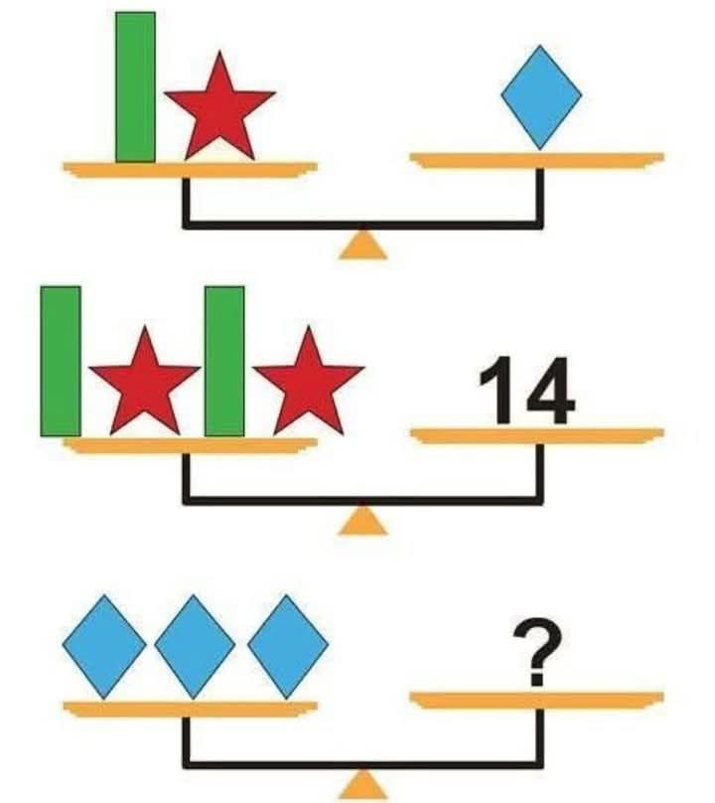
Problem solving

Slide 4
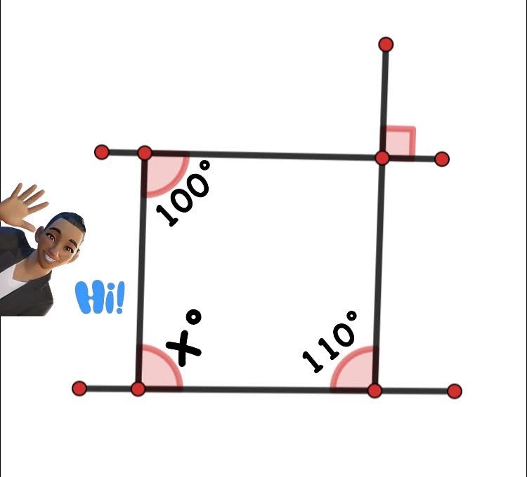
mathematics

Slide 5
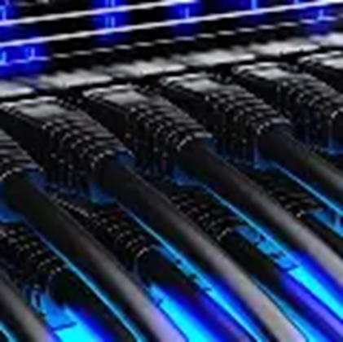
In this lesson
Tasks: x
Lesson feedback
Practical:
Packet Tracer
Assessment:
Online
Maths:
Geometry
English:
Reading
Soft Skills:
Presentation (some)
Problem solving
E&D: All material available for non attendees

Slide 6
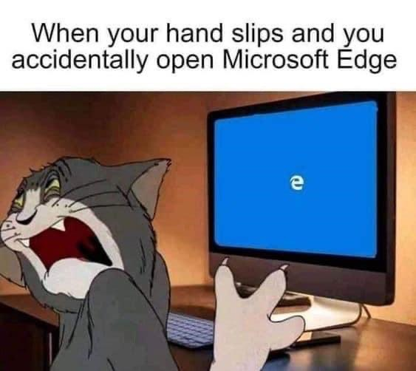
Is this you??

Slide 7
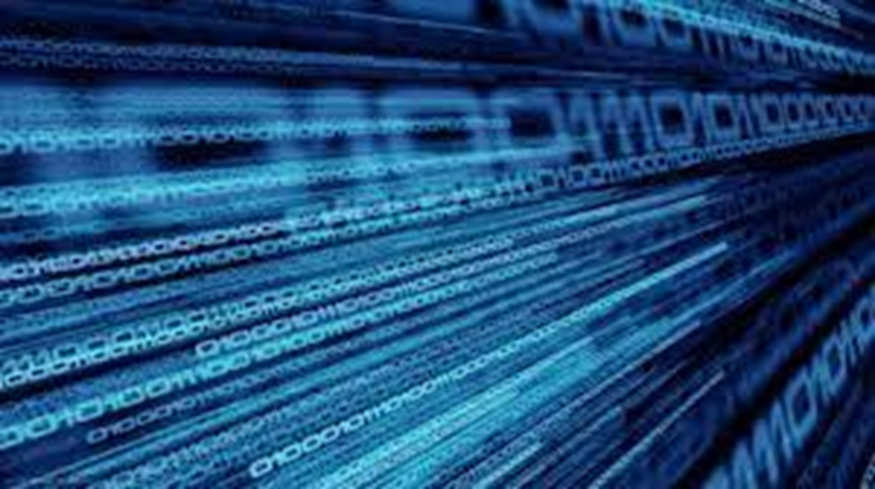
Aim
To understand the features and use of different types of hardware devices

Slide 8
7.1.2
Students will need to understand the features and uses of different types of hardware devices.
They will need to know that input devices allow data to be entered into a system, output devices present information, and processors perform computations, with features such as number of cores, clock speed, cache size, and mobile processors and how these affect processor performance.
Students will need to understand that main memory includes RAM for temporary storage and ROM for permanent instructions, and that secondary storage can be magnetic, solid state, or optical.
They will need to know the role of motherboards, graphics processing units, and network interface devices (PCI and USB), as well as cooling methods (air and liquid) and sensors.
Students will need to be able to explain the purpose of each device and identify which device is needed in a given situation.

Slide 9
Understand the features and characteristics of hardware and peripherals used in physical computer systems
input devices
output devices
processors
main memory
secondary storage
Motherboard
GPU
Network interface devices
cooling
sensors

Slide 10
Diagram of a Computer: Task 1: In small teams how many devices can you name for each box
MAIN
MEMORY
INPUT
DEVICES
OUTPUT
DEVICES
PROCESSOR
SECONDARY STORAGE
Key : Peripherals

Slide 11
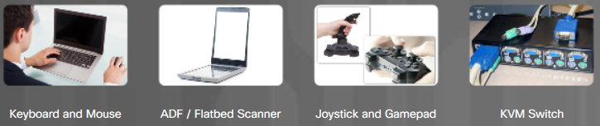
The Original Input Devices
Input devices all the user to communicate with a computer.
Some of the first input devices include:
Keyboard and Mouse – these are the two most commonly used input devices
ADF / Flatbed Scanner – these devices digitize an image or document
Joystick and Gamepad – these devices are used for playing games
KVM Switch – a hardware device that can be used to control more than one computer while using a single keyboard, monitor, and mouse
Notes:
1 – Introduction to Personal Computer Hardware
1.2 – PC Components
1.2.9 – Input Devices
1.2.9.1 – The Original Input Devices

Slide 12
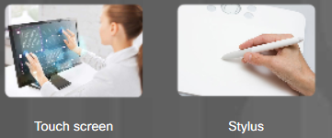
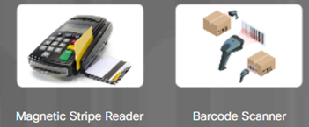
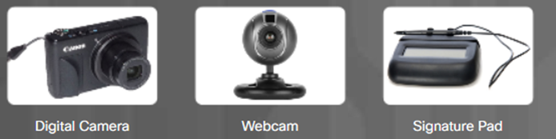

PC Components New Input Devices
Some new input devices include touch screen, stylus, magnetic strip reader, and barcode scanner:
Touch screen – input devices with touch or pressure sensitive screens
Stylus – a type of digitizer that allows a designer or artist to create artwork by using a pen-like tool
Magnetic strip reader – a device that reads information magnetically encoded on the back of plastic cards
Barcode scanner – a device that reads the information contained in the barcodes affixed to products
A few newer input devices:
Digital camera – devices that capture digital images and videos
Webcams – video cameras that can be integrated into a computer
Signature pad– a device that electronically captures a person’s signature
Smart card reader – a device used on a computer to authenticate the user. A smart card may be the size of a credit card with an embedded microprocessor that is typically under a gold contact pad on one side of the card.
Microphone – a device that allows a user to speak into a computer and have their voice digitized
Notes:
1 – Introduction to Personal Computer Hardware
1.2 – PC Components
1.2.9 – Input Devices
1.2.9.2 – New Input Devices

Slide 13
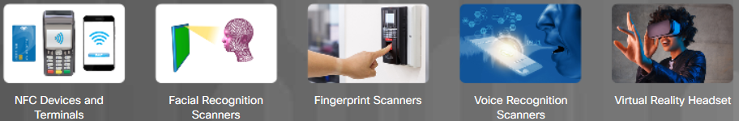
Most Recent Input Devices
The newest input devices include NFC devices and terminals, facial recognition scanners, fingerprint scanners, voice recognition scanners, and virtual reality headsets:
NFC devices and terminals – Near Field Communication (NFC) tap to pay devices
Facial recognition scanners – devices identifying a user based on unique facial features
Fingerprint scanners – devices identifying a user based on unique fingerprint
Voice recognition scanners – devices identifying a user based on unique voice
Virtual reality headset – used with computer games, simulators, and training applications with virtual reality functionalities.
Notes:
1 – Introduction to Personal Computer Hardware
1.2 – PC Components
1.2.9 – Input Devices
1.2.9.4 – Most Recent Input Devices
1.2.9.5 – Check Your Understanding - Input Devices

Slide 14
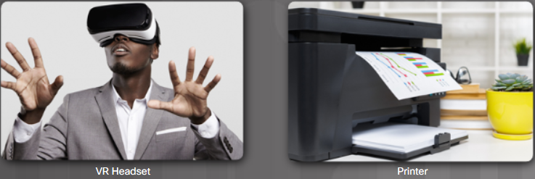
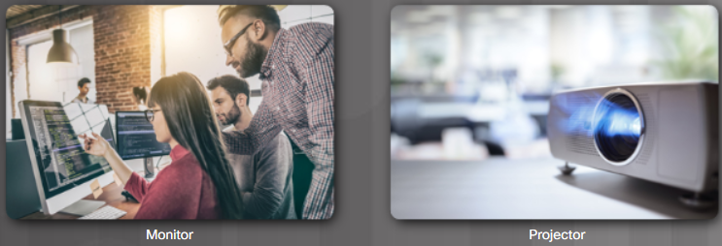
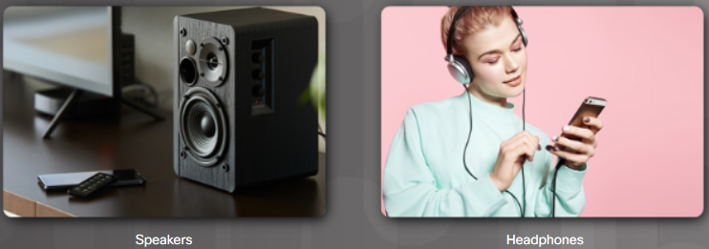
What are Output Devices?
An output device takes binary information from the computer and converts it into a form that is easily understood by the user.
Examples of output devices include monitors, projectors, VR headsets, printers, speakers, and headphones.
Notes:
1 – Introduction to Personal Computer Hardware
1.2 – PC Components
1.2.10 – Output Devices
1.2.10.1 – What are Output Devices?

Slide 15
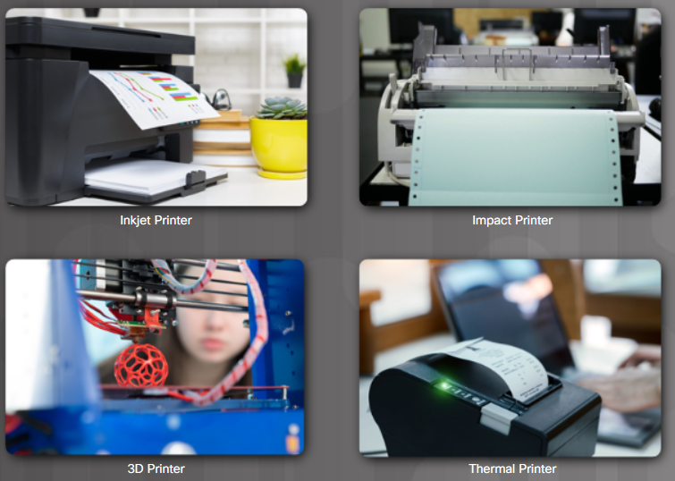
Printers
Printers are output devices that create hard copies of files.
A hard copy might be a on a sheet of paper. It could also be a plastic form created from a 3D printer.
Different types of printers:
Inkjet, impact, thermal, laser, and 3D printers
Printers use wired or wireless connections
All printers require printing material (such as ink, toner, liquid plastic, etc.)
Printers use a driver to communicate with OS
Notes:
1 – Introduction to Personal Computer Hardware
1.2 – PC Components
1.2.10 – Output Devices
1.2.10.4 – Printers

Slide 16
Speakers and Headphones
Speakers are a type of auditory output device.
Most computers and mobile devices have audio support either integrated into the motherboard or on an adapter card.
Headphones, earbuds, and the earphones found in headsets are all auditory output devices.
These may be wired or wireless. Some are Wi-Fi or Bluetooth-enabled.
Notes:
1 – Introduction to Personal Computer Hardware
1.2 – PC Components
1.2.10 – Output Devices
1.2.10.5 – Speakers and Headphones
1.2.10.6 – Check Your Understanding - Visual and Auditory Output Device Characteristics

Slide 17
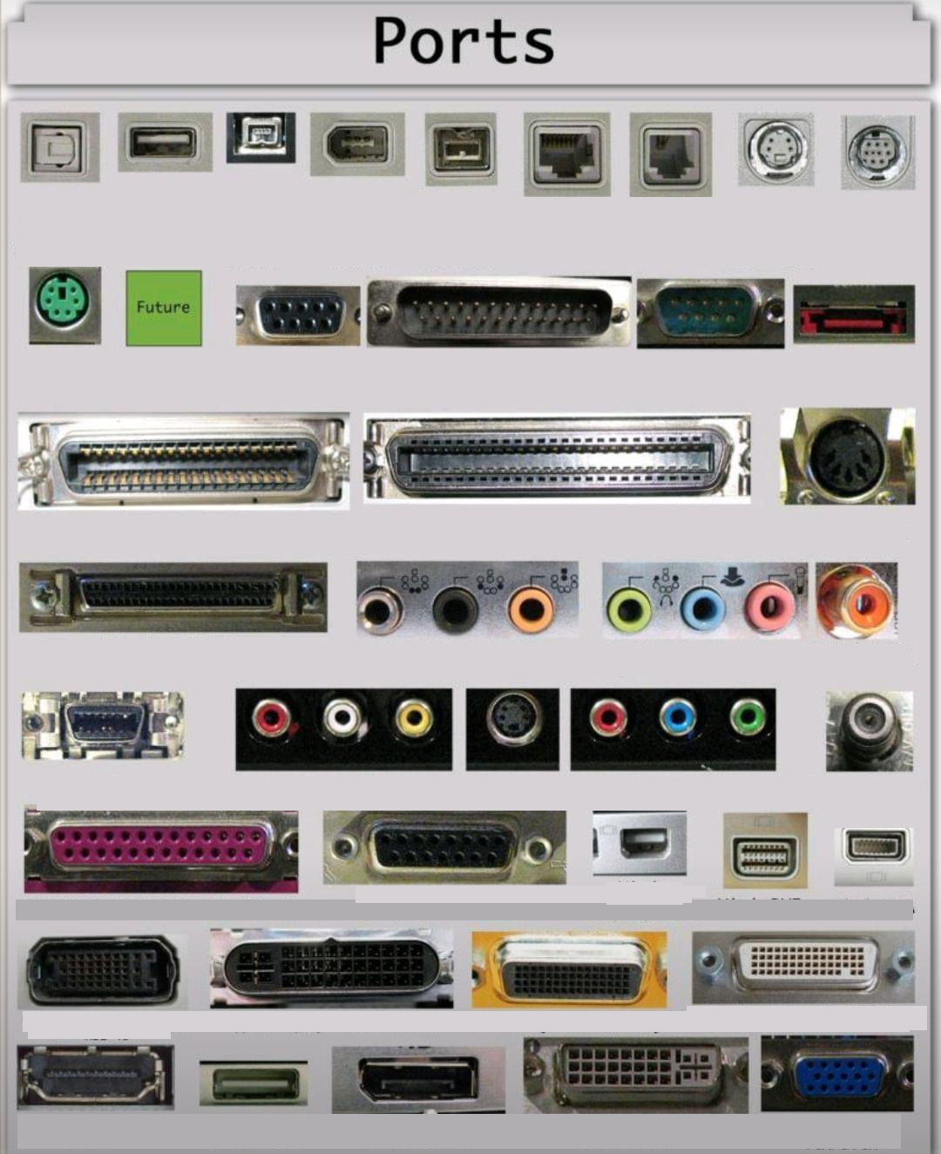
How many can you recognise and name?

Slide 18
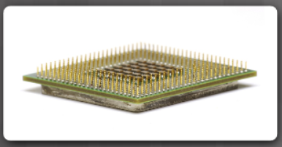
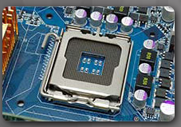
What is a CPU?
The central processing unit (CPU) is responsible for interpreting and executing commands.
The CPU is a small microchip that resides within a CPU package.
The CPU socket is the connection between the motherboard and the processor.
Modern CPU sockets and processor packages are built in following architectures:
Pin Grid Array (PGA) - the pins are on the underside of the processor package and is inserted into the motherboard CPU socket.
Land Grid Array (LGA) - the pins are in the socket instead of on the processor.
Notes:
1 – Introduction to Personal Computer Hardware
1.2 – PC Components
1.2.3 – CPU and Cooling Systems
1.2.3.1 – What is CPU?

Slide 19
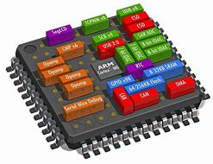
Choices of CPU (factors)
The features and implications of embedded and mobile central processing unit (CPU) architecture.
The features and implications of microcomputer CPU architecture.
The features and implications of server CPU architecture.
(SoC) CPU architecture in the handheld gaming device. suitability of this type of microcomputer architecture for the intended purpose.
SOC = System on A chip

Slide 20
CPU’s <Expand>
They can have a number of cores which increases the number of instructions that can be executed at the same time
They have various cache sizes which results in fewer read operations from main memory
They have various clock speeds where faster clock cycles mean that more instructions can be executed per unit of time
They are affected by temperature as overheating causes a CPU to slow down

Slide 21
CPU Task: Choice of CPU
Using the Internet.
Investigate and Identify the CPUs available for the following types of Computers
mobile
microcomputer
server
handheld gaming device
You should identify and state the key features
Complete Worksheet: Choice of CPU

Slide 22
SOC
SOC is the packaging of all the necessary electronic circuits and parts for a 'system' (such as a handheld gaming device) onto a single integrated circuit or microchip.
1
Despite being on a single chip SoC has cores that are independent of each other, so only need to be turned on when needed. Whereas a traditional processor would be turned on all the time (reducing power consumption and heat production).
2
Many new SoC have a core that is dedicated to power management which controls processes, etc. to maximise battery life which is important for a handheld device. SoC systems usually require less power to run them.
3
A complex SoC may include the on-chip integration of the CPU and a graphics processor unit (GPU) with various other hardware blocks (e.g. image processor, audio/video decoder).
4
No need for additional cooling, which would allow the developers to include additional features in the device (such as larger screen, speaker, etc.) while also keeping the overall size of the case and weight of the device down.
5
Software can be embedded on the chip reducing the need for additional storage/reducing demand on lower memory size of mobile devices. However firmware, etc. is more difficult to update which can be problematic if security issues are found, etc.
6
Easy to embed modern protocols on to the chip as no need to communicate over additional busses, etc., with additional hardware as all components can be integrated and use the same instruction set.
7
Greater system reliability as less connections to be damaged by constant movement (due to reduced number of components on a PCB).
8
Performance of SoC is usually inferior to desktop/traditional CPU architecture. Because of this games may not be able to have the same level of refinement/sophistication as a game on platform that uses desktop architecture. Games that are not optimised for this architecture may ‘lag’ and provide very poor user experience.
9

Slide 23
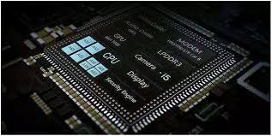
SoC
Attempt the online Quiz: SoC

Slide 24
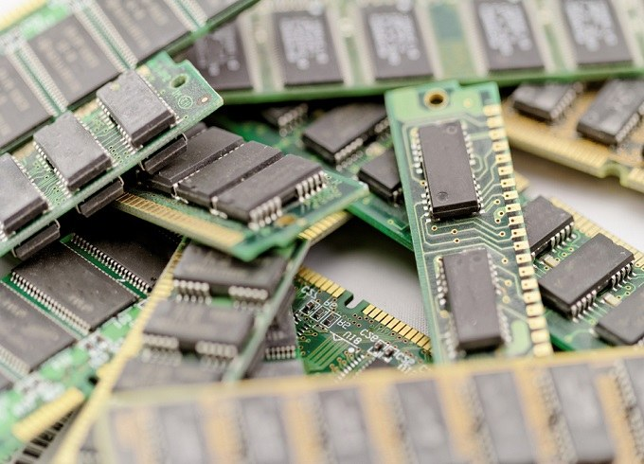
Types of Memory
A computer might use different types of memory chips.
All memory chips store data in the form of bytes.
A byte is a block of eight bits stored as either 0 or 1 in the memory chip.
Read-Only Memory (ROM) – such as ROM chip.
Random Access Memory (RAM) is the temporary working storage for data and programs that are being accessed by the CPU. RAM is volatile memory.
Adding more RAM in a computer enhances the system performance. However, the maximum amount of RAM that can be installed is limited by the motherboard.
Notes:
1 – Introduction to Personal Computer Hardware
1.2 – PC Components
1.2.4 – Memory
1.2.4.1 – Types of Memory

Slide 25
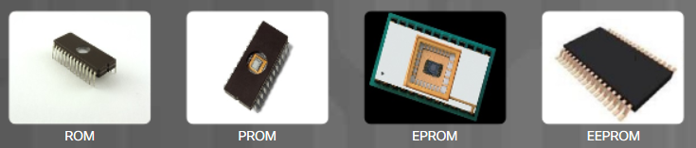
Types of ROM
Types of Read-only Memory (ROM) include:
ROM chips.
PROM chips.
EPROM chips
EEPROM chips.
Notes:
1 – Introduction to Personal Computer Hardware
1.2 – PC Components
1.2.4 – Memory
1.2.4.2 – Types of ROM

Slide 26
Types of RAM
Types of Random Access Memory (RAM) include:
Dynamic RAM (DRAM)
Static RAM (SRAM)
Synchronous Dynamic RAM (SDRAM)
Double Data Rate Synchronous Dynamic RAM (DDR SDRAM)
DDR2 Synchronous Dynamic RAM (DDR2 SDRAM)
DDR3 Synchronous Dynamic RAM (DDR3 SDRAM)
DDR4 Synchronous Dynamic RAM (DDR4 SDRAM)
DDR5 Synchronous Dynamic RAM (DDR4 SDRAM)
Notes:
1 – Introduction to Personal Computer Hardware
1.2 – PC Components
1.2.4 – Memory
1.2.4.3 – Types of RAM

Slide 27
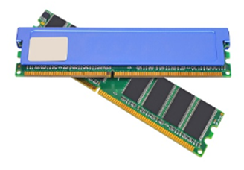
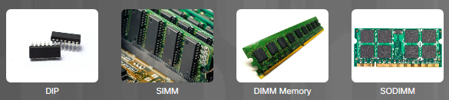
PC Components Memory Modules
Memory chips are soldered to a circuit board to create a memory module which is placed into a memory slot on the motherboard.
Different types of memory modules include: DIP, SIMM, DIMM memory, and SODIMM.
The speed of memory has a direct impact on how much data a processor can process in a given period of time.
The fastest memory is typically static RAM (SRAM) which is used as cache memory
The speed of memory has a direct impact on how much data a processor can process in a given period of time.
The fastest memory is typically static RAM (SRAM) which is used as cache memory for storing the most recently used data and instructions by the CPU.
The three most common types of cache memory are:
L1 cache – integrated into the CPU
L2 cache – was original mounted on the motherboard, but now integrated into the CPU
L3 cache – used some high-end workstations and server CPUs
Notes:
1 – Introduction to Personal Computer Hardware
1.2 – PC Components
1.2.4 – Memory
1.2.4.4 – Memory Modules
1.2.4.5 – Check Your Understanding - Memory

Slide 28

Memory Modules
Memory errors occur when the data is not stored correctly in the memory chips. The computer uses different methods to detect and correct data errors in memory.
Different types of error checking methods include:
Nonparity – Nonparity memory does not check errors in memory.
Parity – Parity memory contains 8 bits for data and 1 bit for error checking.
ECC – Error Correction Code memory can detect multiple bit errors in memory and correct single bit errors in memory
Error detection will be covered in the Transmission module
Notes:
1 – Introduction to Personal Computer Hardware
1.2 – PC Components
1.2.4 – Memory
1.2.4.4 – Memory Modules
1.2.4.5 – Check Your Understanding - Memory

Slide 29
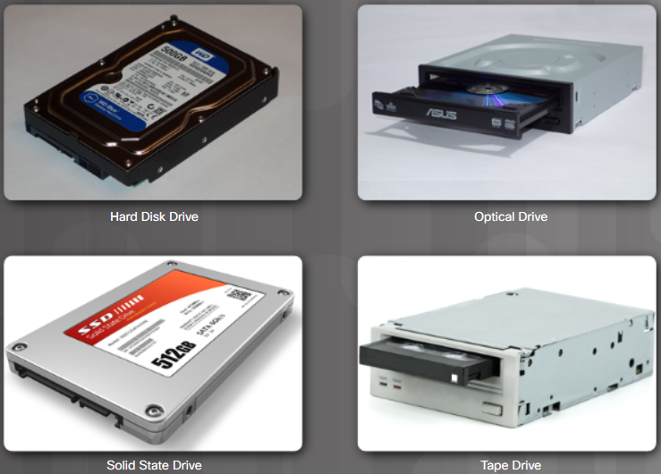
Types of Storage Devices
Data drives provide non-volatile storage of data.
Some drives have fixed media, and other drives have removable media.
Data storage devices can be classified according to the media on which the data is stored:
Magnetic – like hard disk drive and tape drive
Solid state – like solid state drive
Optical – like CD and DVD
Notes:
1 – Introduction to Personal Computer Hardware
1.2 – PC Components
1.2.6 – Hard Disk Drives and SSDs
1.2.6.1 – Types of Storage Devices

Slide 30
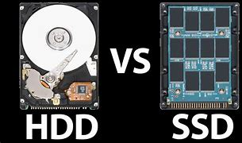
Choices of storage device
HDD or SDD ?

Slide 31
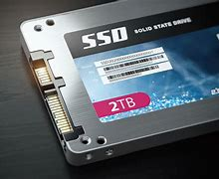
Storage devices Solid state drives
Lower capacity
More expensive
No Mechanical/moving parts
Low power rated
Do not overheat
Shockproof
Less vibrations
Small form factor
Data fragmented does not slow down performance.
Do you agree with all the above?

Slide 32
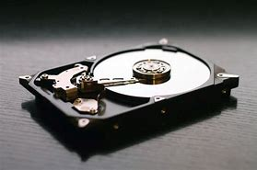
Storage devices HDD
Higher capacity
Cheaper
Mechanical/moving parts
High power rated
Can overheat
Not Shockproof
The moving points of a HDD creates vibrations
Large form factor
HDDs use spinning platters and moving heads to read and write data, which can get fragmented over time and slow down performance.
Do you agree with all the above?

Slide 33

Task: analyse the previous two slides and proof the statements are correct

Slide 34
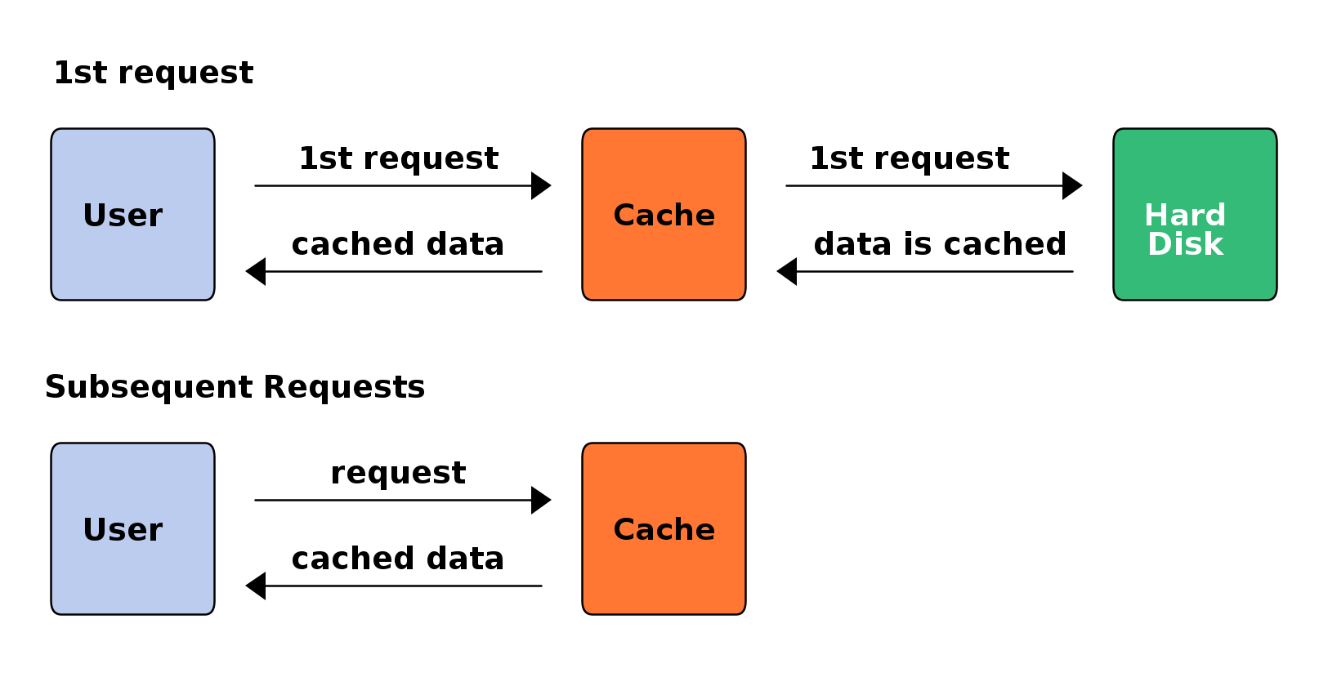
HDD Disk cache
Disk cache evens out the data flow between the hard disk and the memory.
It stores data that is being written to/ read from the disk in a temporary memory space and then transfer it in smaller batches to the disk or the memory.
The HDD does not have to wait for the data to be fully processed before it can perform other tasks, and the memory does not have to wait for the data to be fully retrieved from the disk before it can access it.
This improves the performance and efficiency of both the disk and the memory.
Disk Cache Video

Slide 35
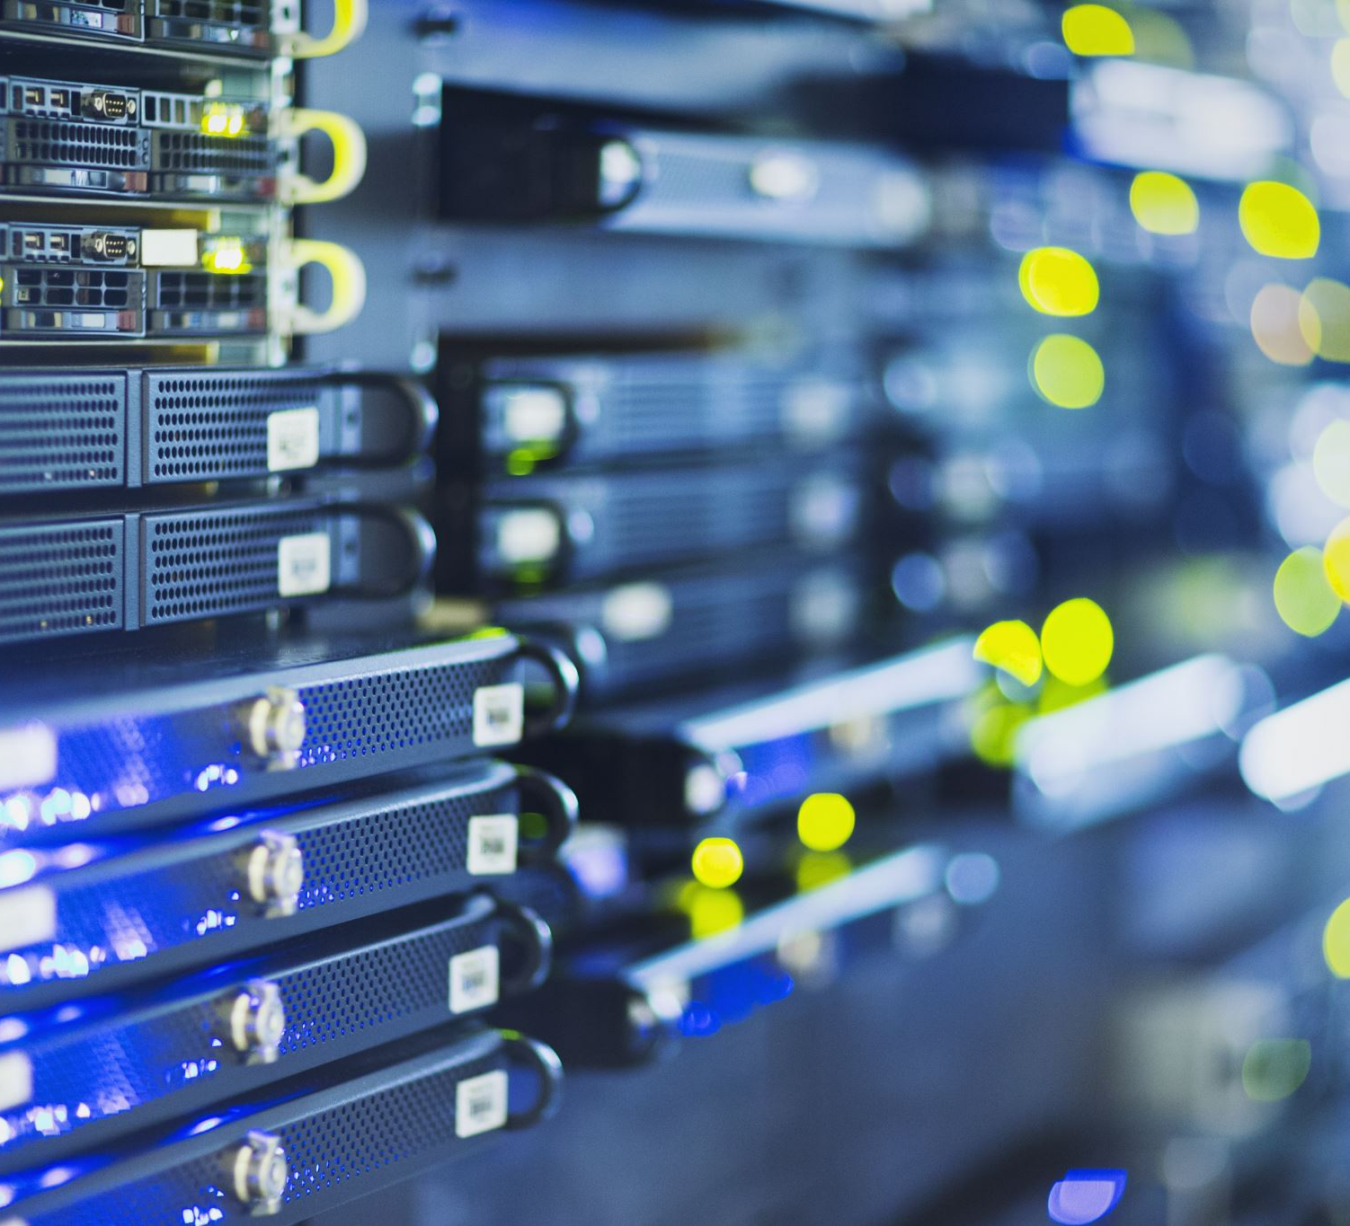
Disk cache
Also known as a disk buffer or disk cache buffer, plays a crucial role in enhancing the performance of a computer's storage system, whether it's a hard disk drive (HDD) or a solid-state drive (SSD).
The primary function of a disk cache is to improve read and write operations by temporarily storing frequently accessed data.
Overall, the disk cache is an essential component for improving the speed and efficiency of data access on storage devices and is an integral part of modern computer storage systems.
There are a range of benefits and key roles that they play.
There is a range of techniques that they use:
Read-ahead
Read-behind
Speed matching
Write acceleration
Task: Look at the PowerPoint Disk Cache and then attempt the online quiz: Disk Cache.

Slide 36
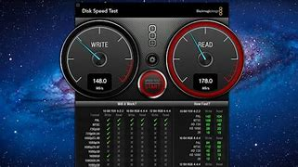
HDD performance
The capacity of a hard drives will affect the speed of data access.
A larger hard drives have higher data density, which means they can read and write data faster than smaller hard drives.
If a hard drive is running low on space, it may start to fragment files and store them in different locations, which can slow down the performance. Therefore, choosing a hard drive with enough capacity for your needs can improve the speed of data access.
Task: Defrag

Slide 37
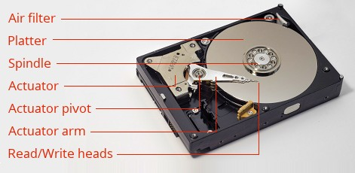
HDD spindle speed
A higher spindle speed would improve performance is by increasing the data transfer rate of a hard drive.
A higher spindle speed means that the platters of the hard drive rotate faster, which allows the read/write head to access the data bits more quickly. This results in higher data rates, which can improve the performance.

Slide 38
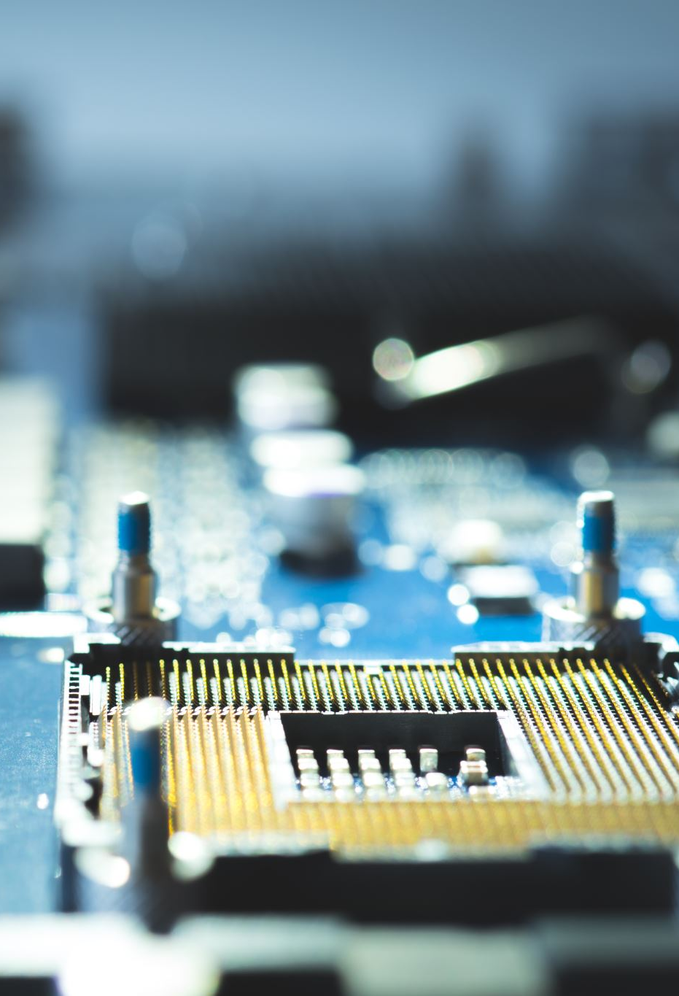
Storage devices Solid state drives (SSD). Exam question Answers
SSDs do not require defragmentation because they store data differently from HDDs. Defragmenting an SSD would not improve its speed but rather wear out its cells faster. Therefore, it is recommended to avoid defragmenting SSDs and let them manage their own data using a technique called wear-levelling.
Power consumption is lower therefore battery life is longer. SSDs consume less power than HDDs, as they do not have moving parts that require electricity to spin.
No mechanical/moving parts which reduces noise and heat generation and the data on the drive will not be corrupted if the device is dropped, which is more likely in a handheld device than a desktop computer. Its more Shockproof.
Data is written electronically, so data can be accessed while the device is being moved, without risk of interruption or corruption.
Lighter in weight than HDDs, Smaller size provides more space in a mobile device for other components that will improve the ways the device can be used (GPS sensor, camera/image sensor, larger battery).
Do not overheat. Heat/Cooling SSDs generate less heat than HDDs, which can reduce the cooling fan usage and save battery life so does not require additional cooling methods, which allows for smaller and lighter devices
Small and light. Does not use ‘disks’, write heads etc. so can be manufactured smaller. Smaller form factor allows them to be incorporated into smaller devices
Mobile
Speed. SSDs are much faster than HDDs in terms of data access, boot time, file transfer, and application loading. Fast access use flash memory chips that can access any data block equally fast, regardless of where it is located.
Better performance. They also have lower delay (latency) and higher reliability than HDDs. Hence, they can improve the overall performance of devices by reducing the lag and increasing the responsiveness.
No vibration.
Task: What is wear-levelling?

Slide 39
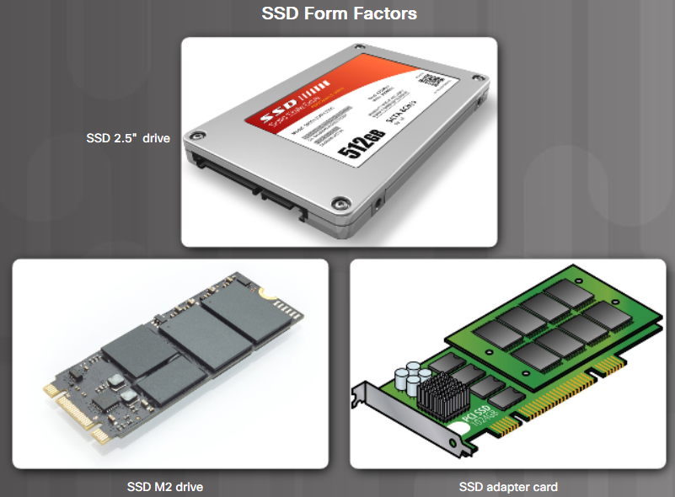
Semiconductor Storage
Solid-state drives (SSD) store data as electrical charges in semiconductor flash memory. This makes SSDs much faster than magnetic HDDs.
SSDs have no moving parts, make no noise, are more energy efficient, and produce less heat than HDDs.
SSDs come in three form factors:
Disc drive form factor – similar to an HDD
Expansion cards – plugs directly into the motherboard and mounts in the computer case like other expansion cards
mSata or M.2 modules – these packages may use a special socket. M.2 is a standard for computer expansion cards.
Notes:
1 – Introduction to Personal Computer Hardware
1.2 – PC Components
1.2.6 – Hard Disk Drives and SSDs
1.2.6.4 – Semiconductor Storage
1.2.6.5 – Check Your Understanding - Data Storage Devices

Slide 40
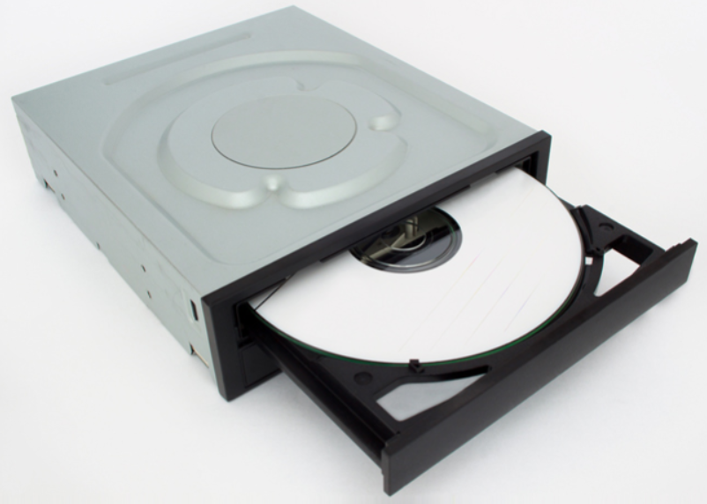
Types of Optical Storage Devices
Optical drives are removable media storage devices that use lasers to read and write data on optical media.
They were developed to overcome the storage capacity limitations of removable magnetic media such as floppy discs.
There are three types of optical drives:
Compact Disc (CD) - audio and data
Digital Versatile Disc (DVD) - digital video and data
Blu-ray Disc (BD) - HD digital video and data
Notes:
1 – Introduction to Personal Computer Hardware
1.2 – PC Components
1.2.7 – Optical Storage Devices
1.2.7.1 – Types of Optical Storage Devices

Slide 41
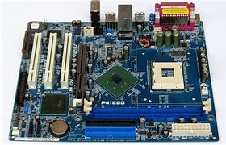
Motherboards
The motherboard is the backbone of the computer.
It is a printed circuit board (PCB) that contains buses, or electrical pathways, that interconnect electronic components.
These components may be soldered directly to the motherboard, or added using sockets, expansion slots, and ports.
Is it safe to touch a motherboard?
Notes:
1 – Introduction to Personal Computer Hardware
1.2 – PC Components
1.2.2 – Motherboards
1.2.2.1 – Motherboards

Slide 42
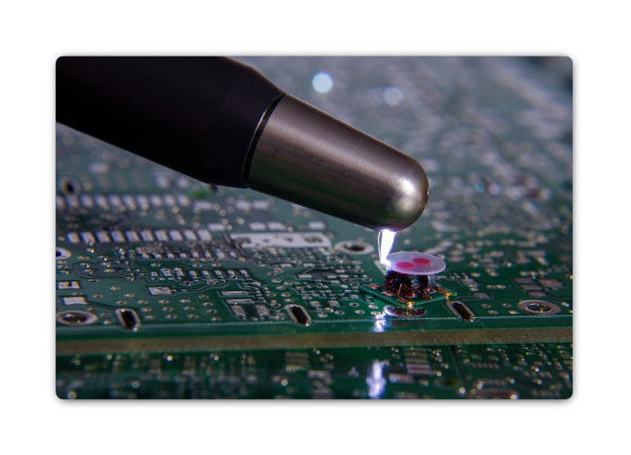
ESD
Electrostatic discharge (ESD) can occur when there is a buildup of an electric charge that exists on a surface which comes into contact with another differently charged surface.
ESD can cause damage to computer equipment if not discharged properly.
At least 3,000 volts of static electricity must build up before a person can feel ESD.
Follow these recommendations to help prevent ESD damage:
Keep all components in antistatic bags until you are ready to install them.
Use grounded mats on workbenches.
Use grounded floor mats in work areas.
Use antistatic wrist straps when working inside computers.
(65) Don't worry, it's just ESD! (Electrostatic Discharge) - YouTube
Notes:
1 – Introduction to Personal Computer Hardware
1.1 – Personal Computer
1.1.2 – Electrical and ESD Safety
1.1.2.2 – ESD
1.1.2.3 – Check Your Understanding – ESD Characteristics

Slide 43
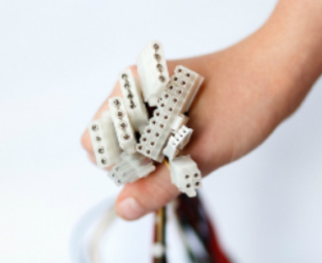
Connectors
A power supply includes several different connectors. They are used to power various internal components such as the motherboard and disk drives.
Some examples are:
20-pin or 24-pin slotted connector
SATA keyed connector
Molex keyed connector
Berg keyed connector
4-pin to 8-pin auxiliary power connector
6/8-pin PCIe power connector
Task: Connectors
Download and complete the worksheet: Connectors
Notes:
1 – Introduction to Personal Computer Hardware
1.2 – PC Components
1.2.1 – Case and Power Supplies
1.2.1.3 – Connectors

Slide 44
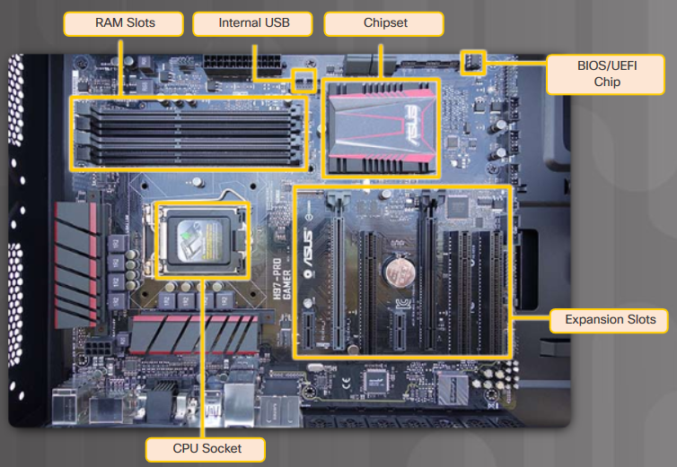
Motherboard Components
Major components on a motherboard include:
Central Processing Unit (CPU)
Random Access Memory (RAM)
Expansion slots
Chipset
Basic input/output system (BIOS) chip and Unified Extensible Firmware Interface (UEFI) chip
SATA connectors
Internal USB connector
Worksheet: Motherboard components
Notes:
1 – Introduction to Personal Computer Hardware
1.2 – PC Components
1.2.2 – Motherboards
1.2.2.2 – Motherboard Components

Slide 45
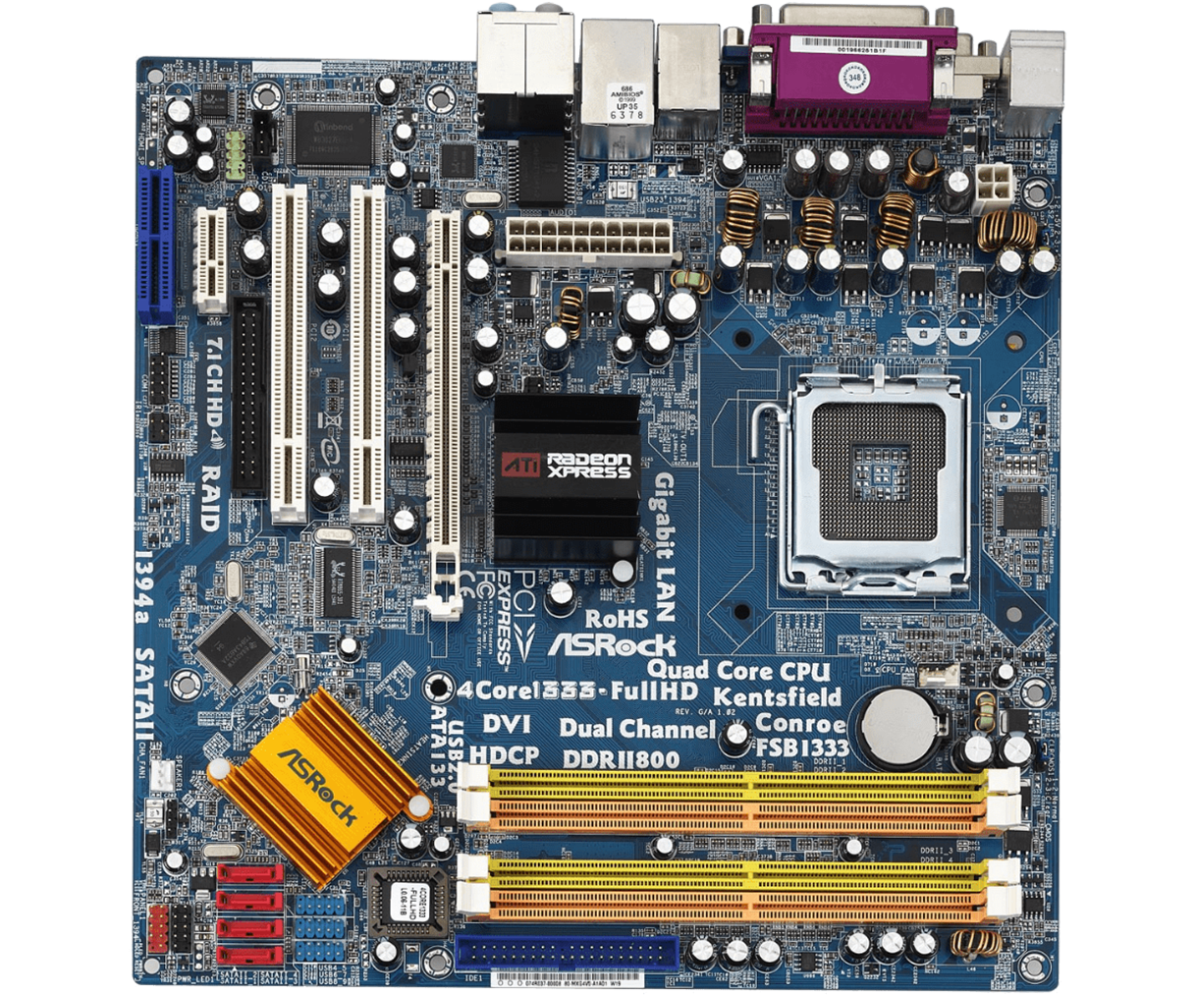
Motherboard

Slide 46
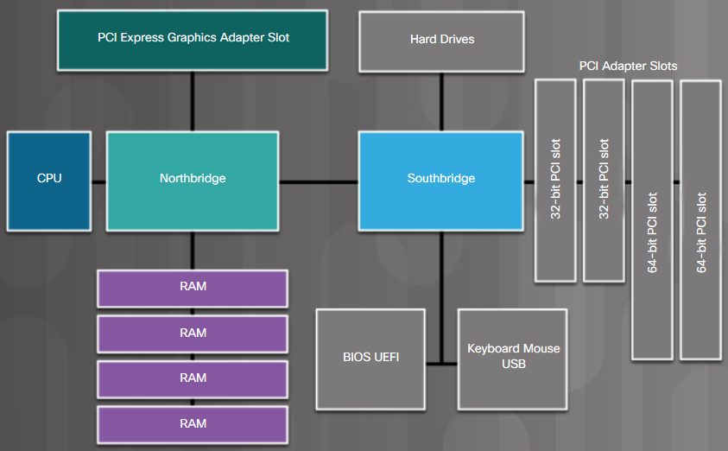
Motherboard Chipset
Chipset consists of the integrated circuits on the motherboard that control how system hardware interacts with the CPU and motherboard.
Most chipsets consist of the following two types:
Northbridge – Controls high speed access to the RAM and video card.
Southbridge – Allows the CPU to communicate with slower speed devices including hard drives, Universal Serial Bus (USB) ports, and expansion slots.
What do the following stand for:
RAM, BIOS, UEFI, CPU, PCI, USB
Notes:
1 – Introduction to Personal Computer Hardware
1.2 – PC Components
1.2.2 – Motherboards
1.2.2.3 – Motherboard Chipset

Slide 47
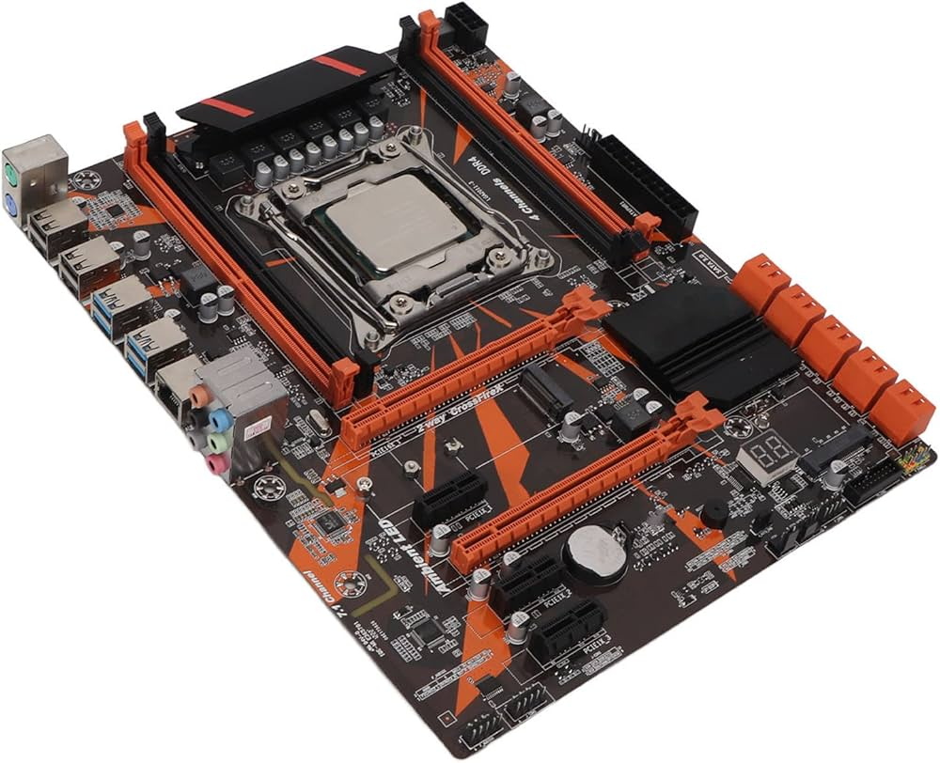
Task: Motherboard

Slide 48
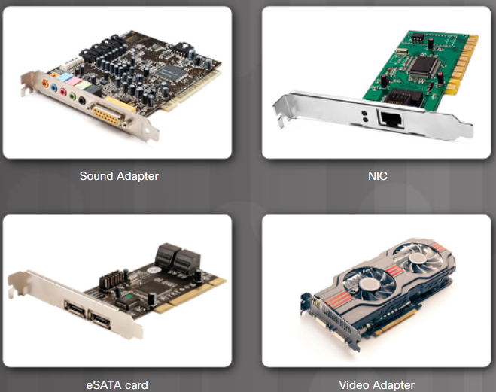
Adapter Cards
Adapter cards increase the functionality of a computer by adding controllers for specific devices or by replacing malfunctioning ports.
Common adapter cards include:
Sound adapter
Network Interface Card (NIC)
Wireless NIC
Video adapter or display adapter
Capture card
TV tuner card
Universal Serial Bus (USB) controller card
eSATA card
Notes:
1 – Introduction to Personal Computer Hardware
1.2 – PC Components
1.2.5 – Adapter Cards and Expansion Slots
1.2.5.1 – Adapter Cards
1.2.5.2 – Check Your Understanding - Adapter Cards and Expansion Slots

Slide 49
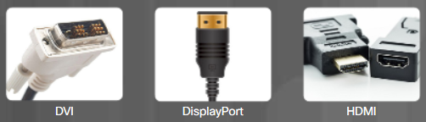
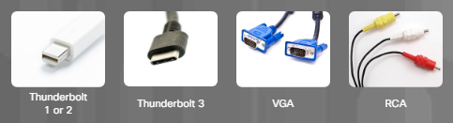
Video Ports and Cables
A video port connects a monitor to a computer using a cable.
Video ports and monitor cables transfer analog signals, digital signals, or both.
Video ports and cables include:
Digital Visual Interface (DVI)
DisplayPort
High-Definition Multimedia Interface (HDMI)
Thunderbolt 1 or 2
Thunderbolt 3
Video Graphics Array (VGA)
Radio Corporation of America (RCA)
Notes:
1 – Introduction to Personal Computer Hardware
1.2 – PC Components
1.2.8 – Ports, Cables, and Adapters
1.2.8.1 – Video Ports and Cables

Slide 50
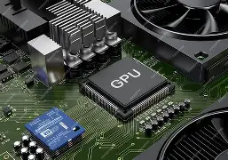
Graphics Processing Devices
Graphics Processing Devices (GPUs) are specialized electronic circuits designed to accelerate digital image processing and to enhance computer graphics.
They are present in various devices, including video cards, system boards, mobile phones, personal computers, workstations, and game consoles.
GPUs are essential for tasks such as graphics rendering, video editing, and machine learning, and they have evolved significantly over the years to handle complex calculations and parallel workloads.
It’s primarily responsible is for the handling the complex calculations required to create images and graphics on a computer. It processes data related to geometry, colour, shading, and textures, enabling the smooth rendering of visuals in applications ranging from video games to professional design software.
The GPU works alongside the central processing unit (CPU), which handles general tasks, while the GPU focuses on graphics-specific computations.
They have multiple Cores: GPUs consist of many smaller cores designed for multitasking, allowing them to execute numerous threads simultaneously. This architecture is particularly effective for tasks that can be parallelised.
High Memory Bandwidth: GPUs typically have high memory bandwidth, enabling them to quickly access and process large amounts of data, which is essential for rendering high-resolution graphics and performing complex calculations.
Programmability: Modern GPUs are highly programmable, allowing developers to create custom algorithms for various applications beyond traditional graphics rendering. This flexibility has expanded their use in diverse fields.
https://support.microsoft.com/en-gb/windows/all-about-graphics-processing-units-gpus-e159bedb-80b7-4738-a0c1-76d2a05beab4

Slide 51
Primary Functions of a GPU
Parallel Processing: Unlike CPUs, which are optimized for sequential processing, GPUs are designed to handle thousands of threads simultaneously. This parallel architecture allows GPUs to perform multiple calculations at once, making them ideal for tasks that require heavy computational workloads, such as 3D rendering and video processing.
Machine Learning and AI: GPUs have become crucial in the fields of artificial intelligence and machine learning. Their ability to perform parallel computations allows them to efficiently handle large datasets and complex algorithms, significantly speeding up training times for neural networks.
Scientific Computing: Beyond graphics, GPUs are used in scientific simulations and data analysis. They excel in tasks that involve matrix operations and vector calculations, which are common in scientific computing.
Cryptocurrency Mining: The parallel processing capabilities of GPUs have made them popular for cryptocurrency mining, where they can perform the necessary calculations much faster than traditional CPUs.
Architectural Features

Slide 52
Network Interface devices
A Network Interface Device (NID) is a crucial component in telecommunications that serves as the demarcation point between a service provider's network and a customer's internal wiring.
It efficiently connects the customer's on-premise wiring with the carrier's local cabling, ensuring proper communication and data flow. Additionally, it is also referred to as a network interface unit (NIU) and plays a vital role in managing the interface between the provider's network and the customer's internal network

Slide 53
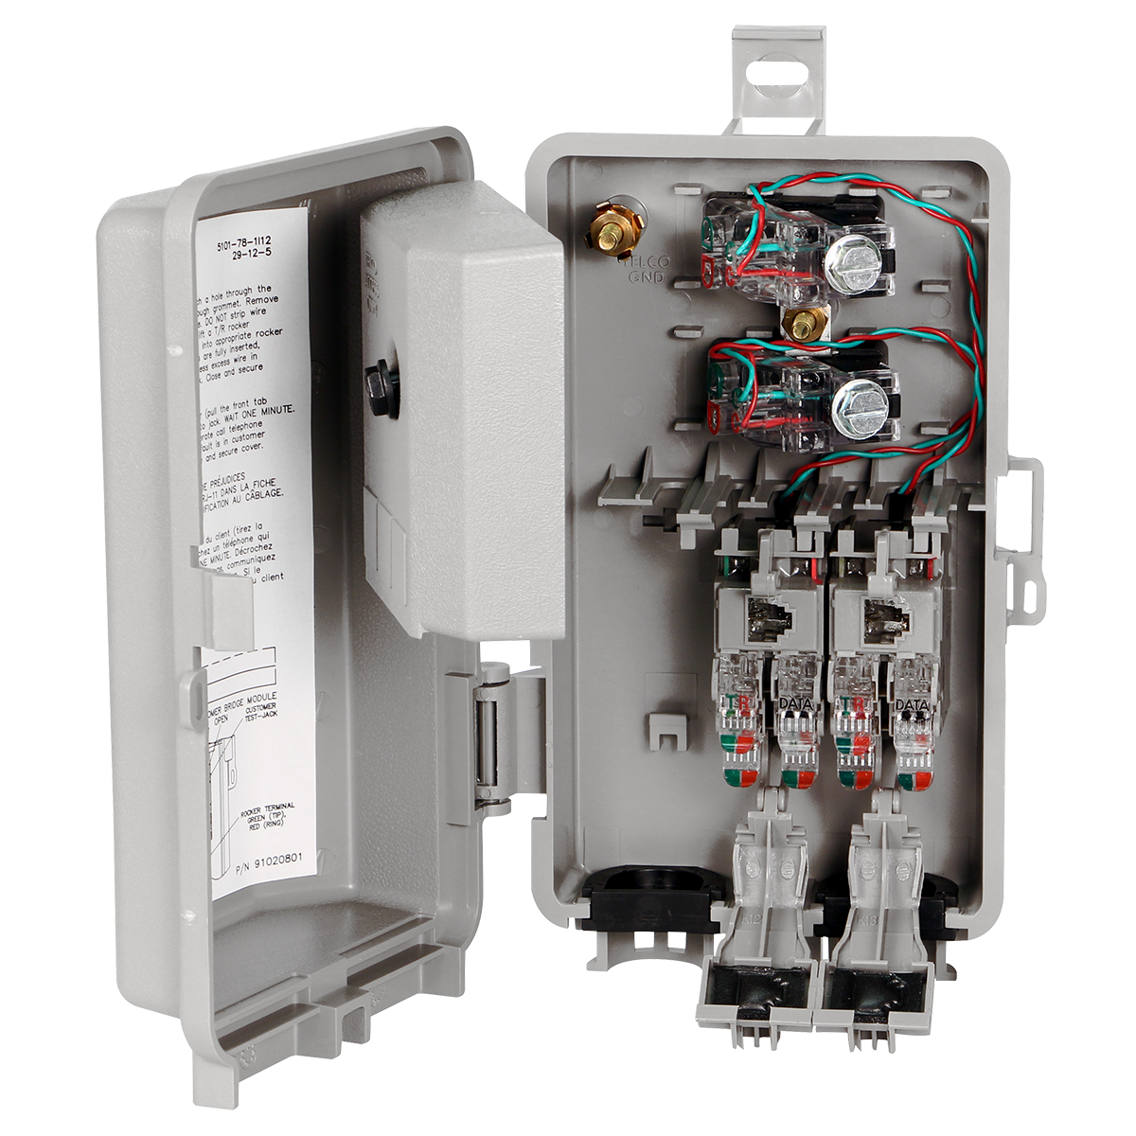
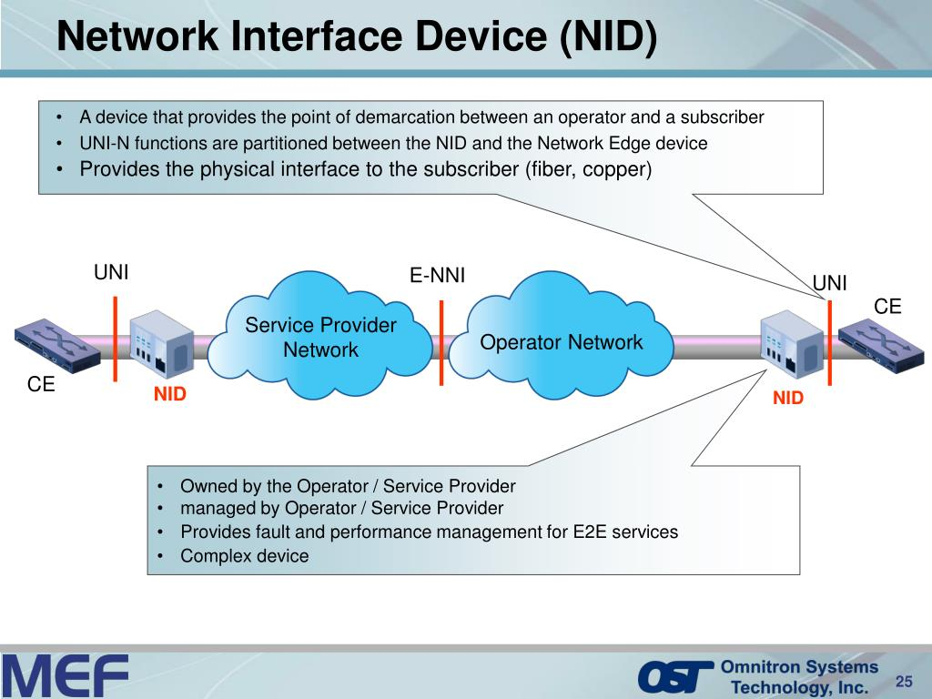

Slide 54

Sensors
A device that converts signals from one energy domain to an electrical domain.
Sensors are devices that detect and respond to changes in their environment, converting physical changes into measurable signals.

Slide 55


USB (Universal Serial Bus)
Designed to standardise the connection of peripherals to computers
Used to connect keyboards, mice, cameras, printers, scanners, flash drives, smartphones, game consoles, and power banks.[
Self-configuring
Hot Swappable
Small devices can be powered directly from the USB interface, eliminating the need for additional power supply cables
USB cables are limited in length

Slide 56

PCI (Peripheral Component Interconnect)
Computer bus standard used to connect devices on a computer motherboard which then communicates with the CPU.
Replaced by PCIe (Faster).

Slide 57


Cooling Systems
Computer components perform better when kept cool.
Computers are kept cool using:
Active cooling
Passive cooling
Active solutions require power while passive solutions do not.
Passive solutions for cooling usually involve reducing the speed at which a component is operating or adding heat sinks to computer chips.
A case fan is considered as active cooling. Not available on mobile devices
Notes:
1 – Introduction to Personal Computer Hardware
1.2 – PC Components
1.2.3 – CPU and Cooling Systems
1.2.3.2 – Cooling Systems
1.2.3.3 – Check Your Understanding - CPUs and Cooling Systems

Slide 58
Cooling Systems
 | Active cooling | Passive cooling
Heat sink
Fan
Clock reduction
PC
Laptop
Mobile Phone
Server
Tablet
Active solutions require power while passive solutions do not.
Notes:
1 – Introduction to Personal Computer Hardware
1.2 – PC Components
1.2.3 – CPU and Cooling Systems
1.2.3.2 – Cooling Systems
1.2.3.3 – Check Your Understanding - CPUs and Cooling Systems

Slide 59

types of sensors
Temperature Sensors: Measure temperature changes.
IR Sensors: Detect infrared radiation.
Proximity Sensors: Detect the presence of nearby objects without physical contact.
Motion Sensors: Detect movement in a specified area.
These sensors are widely used in applications such as automation, environmental monitoring, and safety systems.

Slide 60
Type of Sensor | Used For
Temperature Sensor | Controlling HVAC systems in homes and offices
Proximity Sensor | Detecting objects in automatic doors
Accelerometer Sensor | Screen orientation in smartphones
IR Sensor (Infrared Sensor) | Remote controls for TVs and other devices
Pressure Sensor | Monitoring tire pressure in vehicles
Light Sensor | Adjusting screen brightness on smartphones
Ultrasonic Sensor | Parking assistance in cars
Flow and Level Sensor | Managing water levels in tanks
Smoke, Gas and Alcohol Sensor | Detecting smoke and gas leaks in homes
Microphone (Sound Sensor) | Voice recognition in smart speakers
Touch Sensor | Touchscreens on smartphones and tablets
Colour Sensor | Colour detection in industrial sorting machines
Humidity Sensor | Controlling humidity levels in greenhouses
Magnetic Sensor (Hall Effect Sensor) | Detecting the position of a rotating object
Position Sensor | Tracking the position of machine parts
Tilt Sensor | Detecting the tilt of gaming controllers
PIR Sensor | Motion detection in security systems
Strain and Weight Sensor | Weighing items on digital scales
Gyroscope Sensor | Stabilizing drones during flight
Optical Sensor | Adjusting lighting in smart home systems
Capacitive Sensor | Touchpads on laptops
Piezoelectric Sensor | Detecting vibrations in musical instruments
Thermal Sensor | Temperature control in ovens
RFID Sensor | Tracking inventory in warehouses
Chemical Sensor | Monitoring air quality
https://www.electronicshub.org/different-types-sensors/

Slide 61



Sensors
Notes:
We live in a World of Sensors. You can find different types of Sensors in our homes, offices, cars etc. working to make our lives easier by turning on the lights by detecting our presence, adjusting the room temperature, detect smoke or fire, make us delicious coffee, open garage doors as soon as our car is near the door and many other tasks. All these and many other automation tasks are possible because of Sensors. Before going in to the details of What is a Sensor, What are the Different Types of Sensors and Applications of these different types of Sensors, we will first take a look at a simple example of an automated system, which is possible because of Sensors (and many other components as well).
The example we are talking about here is the Autopilot System in aircrafts. Almost all civilian and military aircrafts have the feature of Automatic Flight Control system or sometimes called as Autopilot.
Discuss what sensors are, and how they work.
Useful Article: https://www.electronicshub.org/different-types-sensors/
Image from: https://www.electronicshub.org/wp-content/uploads/2017/11/Types-of-Sensors-Image-1.jpg

Slide 62


Activity
Look at the sensors identified below:
Temperature Sensor.
Proximity Sensor.
Accelerometer.
IR Sensor (Infrared Sensor)
Pressure Sensor.
Light Sensor.
Ultrasonic Sensor.
Smoke, Gas and Alcohol Sensor.
For each sensor list a possible use, and a possible industry this could be used in.
Notes:
Task on differences between the types
IoT Blog: https://www.finoit.com/blog/top-15-sensor-types-used-iot/
Image from here: https://www.ccsinfo.com/images/catalog/e3mini-sensor-big.jpg

Slide 63

Assessment
Now complete the online test: Hardware and peripherals used in physical computer systems
Lesson feedback: Now complete the lesson feedback form. Lesson feedback form
Comment on what could be added to make the lesson better
Homework: Retake the online quiz.
Complete the Cisco online course: Exploring Internet of Things with Cisco Packet Tracer
Prepare for the next lesson
Flipping the classroom
Open and preview the following PowerPoint in preparation for the next lesson.
7.2.1 Understand the features and use of operating systems

Slide 64
Independent study:
The following tasks will get you to understand the features of the hardware devices found in a PC.

Slide 65
The purpose, features and uses of internal components used in a computer system
Component | Purpose | Features | Uses
Motherboard
CPU
Memory
Storage
Ram
Power supply
Ports
Fan and heat sink
Task2: In small teams complete the Purpose Column in the table above

Slide 66
The purpose, features and uses of internal components used in multi-functional devices
Component | Purpose | Features | Uses
Motherboard | Has main components plus interfaces to external devices (I/O)
CPU | the boss that controls the whole system
Memory | Rom controls the booting of the system and the I/O handling code
Storage | HDD/SDD
Ram | Stores working programs and data
Power supply | Converts AC to DC and supplies current to all attached devices
Ports | Connect to the outside world
Fan and heat sink | Cools the CPU
Task3: In small teams complete the Features and Uses Columns in the table above

Slide 67
Factors affecting the choice, use and performance of internal components
.
Group Discussion: What factors affects your choice of Internal Components

Slide 68
Hardware Task: Factors affecting the choice, use and performance of internal components.
Using an online computer retailer, ebuyer.com etc
Investigate and select the components for two PC’s
High End Gaming PC
General office PC
You need to enter the specification for the two PCs plus costings including Vat at 20% and delivery at 1.5%
The systems must include: Case, PSU, Mothrboard, CPU, Memory, Storage
Please use Task sheet : Hardware choice

Slide 69
Factors affecting the choice, use and performance of internal components
Users | Does it meet the needs of the user and their tasks
Performance | Has it the right capacity, speed of operation, efficiency and reliability
Cost | How much does it cost. How long will it last. Is it in budget. Is training required
Compatibility | Do the components match the existing devices. Does the operating system support it. Can the required software work.
Form factor | Does it fit
Timescale | Lead time. Implementation time.
Complete Worksheet: Factors Internal components

Slide 70

Factors affecting the choice, use and performance of internal components. Answers from Examiners
User experience
Performance – A computer will be required that can support multitasking and varied workflow.
Accessibility – If the user spends many hours working at the computer it will need to be comfortable to use and consideration of peripherals that are more ergonomic (such as keyboards)
User needs
A large storage capacity is a good idea to store all the various data created. Although cloud storage can make up for shortfalls in local storage using web-based storage for large files that are regularly accessed is inefficient .
A large, high-resolution monitor would be beneficial to allow multiple programs, documents etc. to be seen at once and to reduce eyestrain when using the computer.
Many expansion ports is advisable to allow connection of different peripherals and devices for testing software.
Dedicated high performance GPU

Slide 71

Factors affecting the choice, use and performance of internal components. Answers from Examiners
Compatibility
A computer would need to be compatible with a range of different environments..
Cost
Ideally you need the best possible performance for the lowest price. Compromise could be higher RAM for smaller storage capacity that could be updated later.
Implementation
For immediate use a prebuilt (with o/s) would be ideal and just the required dedicated software needs to be installed.
Building a PC could be more economical and the specification required could be obtained.

Slide 72
CPU’s
They can have a number of cores which increases the number of instructions that can be executed at the same time
They have various cache sizes which results in fewer read operations from main memory
They have various clock speeds where faster clock cycles mean that more instructions can be executed per unit of time
They are affected by temperature as overheating causes a CPU to slow down

Slide 73
CPU Task: Choice of CPU
Using the Internet.
Investigate and Identify the CPUs available for the following types of Computers
mobile
microcomputer
server
handheld gaming device
You should identify and state the key features
Complete Worksheet: Choice of CPU

Slide 74
SoC
Attempt the online Quiz: SoC

Slide 75

Input devices
Keyboards
Button Keypad
Mouse
Trackpad
Stylus
Touchscreen
Microphone
Telephone (VOIP)
Camera
Motion sensor
GPS

Slide 76

Output devices
Monitor:
Video, projector, ATM, EPOS, Satnav
Printers:
Laser, inkjet, 3D, Plotter
Audio:
Speakers, headphones
Control:

Slide 77

How the features of hardware can affect their performance and the performance of a computer system - Input
Faster response times
More accurate resolutions
More controlabity /smoothness
More feedback
Accuracy
Improved ease of use through ergonomics/ form factor
Able to configure
Using the best interface/connector

Slide 78
How the features of hardware can affect their performance and the performance of a computer system - Output
Clarity and accuracy (resolution, sample rate, frame rate, colour depth, contrast).
Noise: the less noise the better
Speed: Higher the volume of printing the better
Automation: Better processing of real time environments. TV, sound systems
Configurable: devices can be customised. Double side printing.

Slide 79
How the features of hardware can affect their performance and the performance of a computer system - Storage
Rotational Latency: Spin speed of HDD
Seek time: the time it takes for the drive's head assembly positioned in the right location on the track to read/write data to a particular sector of the disk
Data transfer: Speed of data transferred from HDD to controller (internal). From the disk controller to memory (external).
Fragmentation: Data dispersed across the storage medium. More fragmentation = slower access time.

Slide 80

Task: How the features of hardware can affect their performance and the performance of a computer system
How does the features of Ram affect performance?
How does the features of Storage affect performance?
How does the features of a CPU affect performance?
Task: Visit a computer retailer. Ebuyer.com etc and complete worksheet Performance 3

Slide 81


Task: Factors affecting choice of hardware
What do you think are the Factors when you buy hardware?

Slide 82
Task: Factors affecting choice of hardware
Cost
Speed

Slide 83

Increasing Clock Speed
A processor with a clock speed or frequency of 2GHz should work twice as fast as a processor with a clock speed of 1GHz.
As a 2GHz processor’s clock cycle is half the duration of the 1GHz processor, it will take half the time to execute an instruction.

Slide 84

Limits on Clock Speed
Clock speed has to be limited, otherwise, the heat generated in the chip by higher clock frequencies can’t be removed quickly enough. The problem is made worse when more transistors are packed into the same amount of room in the chip.
Increasing the number of transistors into the same amount of area increases the power consumption which results in more heat. This also happens when the clock speed is increased.
If transistor density and clock frequency continued to increase, it would eventually generate more heat per square centimetre than is generated on the surface of the sun.

Slide 85
Factors affecting choice of hardware: Monitor
Factor | Description | Units | Best Performance
Refresh rate | How often the complete screen is displayed | Hertz (Hz). Most monitors have a 60Hz refresh rate. | A lower refresh rate will give you visible flicker and less smooth movement.
Response time | A measure of how quickly each pixel of the display can change from one state to another Change of colour/brightness. | Milliseconds | Faster responses produce images with less trailing or ghosting which makes moving images seem blurred.
Brightness | The light output of a monitor | Candela per square metre. The larger the value, the brighter the monitor. | The brighter the monitor the easier it will be to see in bright ambient light or sunshine.
Contrast | A measure of the light and dark areas of an image. | A ratio such as 600:1. The larger the first value, the higher contrast the monitor has. | Higher contract ratio will generally give you a higher quality image with the ability to distinguish between more colours.

Slide 86
Factors affecting choice of hardware: Printer
Factor | Description | Units | Best Performance
Printing speed | How quickly pages can be printed | Pages per minute (ppm). | Larger number indicates a faster printer
First out time | How long a delay before the first page starts to print. | Seconds | Smaller numbers shows that the first page starts printing more quickly.
Maximum printing resolution | How detailed the printed image is. | Dots per inch, often shown as across x down. e.g. 4800 x 1200 | Large numbers show a more detailed image.
Monthly duty cycle | How many pages the printer can easily print a month. | Pages | Large numbers show a more robust design.

Slide 87
Factors affecting choice of hardware: Computer download and Complete the following table
Factor | Description | Units | Best Performance
 | Processor
 | Hard drive
 | Memory
 | Graphics card
 | Operating system
 | Size
 | Cost

Slide 88
Factors affecting choice of hardware: Mobile device download and Complete the following table
Factor | Description | Units | Best Performance
 | Central Processing Unit
 | Batteries
 | Ram
 | ROM
 | Removable storage
 | Input
 | Output
 | Form Factor
https://fossbytes.com/whats-inside-smartphone-depth-look-parts-powering-everyday-gadget/

Slide 89
Factors affecting choice of hardware: Mobile device download and Complete the following table
Factor | Description | Units | Best Performance
Speed, Cost | Central Processing Unit
Voltage | Batteries
Capacity, Speed | Ram
Capacity, Speed | ROM
Capacity, Speed | Removable storage
 | Input
 | Output
Size | Form Factor
https://fossbytes.com/whats-inside-smartphone-depth-look-parts-powering-everyday-gadget/

Slide 90
Exam question
Explain one factor that influences the performance of a Central Processing Unit (CPU)

Slide 91
Explain one factor that influences the performance of a Central Processing Unit (CPU)
Number of cores as increasing the number of cores increase the number of instructions that can be executed at the same time
Cache size as larger caches require fewer read operations from main memory
Clock speed as faster clock cycles mean that more instructions can be executed per unit of time
CPU temperature as overheating causes CPU to slow down

