Slide 1

Content area 7: Digital environments
T Level Technical Qualification in Digital software Development: 7-2-2 Understand the features and use of common utilities
V3.1-1-060625
Presentation by Derek Condon MSc, MBCS, MIET

Slide 2

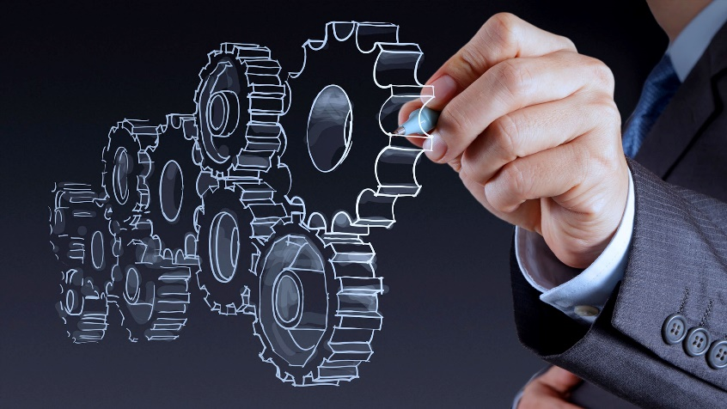

Starter
To get you in the mood

Slide 3

mathematics

Slide 4

Tasks:
Network
Practical’s: Packet Tracer
Assessment: Online
In this lesson you will be doing the following tasks, Practical's and Assessment

Slide 5

Aim
Understand the features and use of common utilities

Slide 6
• file management
• defragmenters
• file compression
• package managers
• protection software
• backup software

Slide 7
Outcomes 7.2.2
You will need to understand:
features and uses of common utility software
need to know that file management utilities organise and manage files
defragmenters optimise storage on magnetic drives
file compression utilities reduce file size for storage or transfer
package managers install and update software
protection software safeguards systems against malware and threats
backup software creates copies of data to prevent loss
Students will need to be able to explain the purpose of each type of utility software and identify which one is needed in a given situation.

Slide 8

Utility software
What is utility software?

Slide 9
Utility software
What is utility software?
Utility software refers to programs designed to help manage, maintain, and control computer resources. These tools perform specific tasks that ensure the system operates efficiently and smoothly.

Slide 10
Utility software
What utility software can you identify?

Slide 11
Software Utility: Download and Complete the Table
Software that is designed to perform a specific task to extend or aid the operating system.
Software | Uses | Features
Encryption Software | To protect data by scrambling the contents using algorithm (which makes use of a key) so that data cannot be read unless the correct key is provided. Used to encrypt data during data transmission or to protect stored data | Uses mathematical algorithms to encode data.
File Managers | Organises and list and locate files and directories on a computer
Firewall | To protect a network or system from unauthorised access with a firewall
Network Utilities | These are software utilities that are designed to analyse and configure various aspects of computer networks. For example, ‘Ping’. The PING utility tests connectivity between two hosts.
Package Managers | A collection of software tools that automates the process of installing, upgrading, configuring, and removing computer programs for a computer’s operating system in a consistent manner.

Slide 12
Software Utility: Download and Complete the Table
Software that is designed to perform a specific task to extend or aid the operating system.
Software | Uses | Features
Anti-Virus/Anti-Malware | Used to prevent, detect and remove malware/viruses
Backup Software | Software that is used to perform a backup. This is the creation of supplementary exact copies of files or databases
Compression Tools | Compression is the method used to make files smaller by reducing the number of bits. This is software that can compress and decompress various file types
Disk Analysers | A diagnostic tool that checks the condition of a computer’s hard drive and reports on available space
Disk Defragmenters | Reorganises data on a hard disk drive (HDD) so related data is grouped together in order to improve search and load times
Disk Partitioners | Used to split a single storage medium into multiple volumes. Allows a user to separate data and use multiple file systems on a single disk.

Slide 13
Factors affecting the choice, use and performance of utility software: Download and Complete the Table
Software that is designed to perform a specific task to extend or aid the operating system.
Software | What Choices do you have, what is their usability and how do they affect performance
Anti-Virus/Anti-Malware
Backup Software
Compression Tools
Disk Analysers
Disk Defragmenters | Reorganises data on a hard disk drive (HDD) so related data is grouped together in order to improve search and load times
Disk Partitioners | Used to split a single storage medium into multiple volumes. Allows a user to separate data and use multiple file systems on a single disk.

Slide 14
Factors affecting the choice, use and performance of utility software: Download and Complete the Table
Software that is designed to perform a specific task to extend or aid the operating system.
Software | What Choices do you have, what is their usability and how do they affect performance
Encryption Software
File Managers
Firewall
Network Utilities
Package Managers

Slide 15
Tasks: Find examples of software for the following:
Anti-Virus/Anti-Malware software
Backup Software
Compression Tools
Disk Analysers
Disk Defragmenters
Disk Partitioners
Encryption Software
Firewall

Slide 16
Software to help manage and maintain PCs / laptops
Manage
User level settings to only allow admin to install/alter software
Use system firewall to allow remote access from the office server/technicians computer only
Ensure computers have unique names/identifiers and use a database to log their issue, update, maintenance etc.
Use of calendars etc to schedule the maintenance, upgrades etc for laptops
Use of back-up software to schedule backups for the system.
Maintain
Automatic updates enabled – set the PCs / laptop to automatically update with standard updates when internet connection available OR set up so that targeted updates are install when connected to the office network.
When setting up the laptops, set up one PC /laptop with all the programs etc. Create a ghost image of this machine and use this to roll set up all other laptops.
Use network management software to roll this image out to multiple computers at the same time, or individual computers as needed.
Task: Can you add to this list

Slide 17
Software to help manage and maintain PCs / laptops
Anti Virus
Compare to virus definitions/database
Identify if code/file is malicious
Alert the user
Quarantine/remove/confirm as safe
Task: Can you add to this list

Slide 18
computer software to help protect data
Operating systems features:
Usernames and passwords to restrict access to the system
access settings (levels of access etc)
timed sessions (e.g. not logging in out of work ours)
disabling concurrent logons form the same username
Utilities
Encryption
Firewalls
Two factor authentication processes
Anti-malware
Anti-phishing
Data back-up and recovery
VPN
Task: Can you add to this list

Slide 19
Protecting your device: Firewalls
They Monitor traffic in and out of the system and remote connections
Checks IP addresses of data/connections and compares with (user defined)
Prevent remote/unauthorised connections
denies access to unknown/suspicious connections/traffic
Filter IP addresses to ensure only authorised connections are allowed in list/rules
Block ports to external traffic to limit the number of attack vectors
Monitors ports
uses packet filtering

Slide 20
Protecting your device: Anti-Malware, Encryption Back up software
Anti-Malware
Perform regular scans of the system to check for suspicious code or actions
• Update the virus database regularly to ensure that definitions are up to date to protect against new/emerging threats.
Encryption software
• Encrypt any data stored on internal and external media (particularly if mobile devices are used) so that if a device is stolen the data cannot be accessed
• Encrypt messages that are sent across public networks I order to protect sensitive information
• Make use of SSH/VPN for staff that need to travel and will be remotely accessing the network via public Wi-Fi.
Back up
Make use of an auto back-up/scheduling software to ensure data is updated to a secure back up so data can be recovered in the case of data breach or critical attack.

Slide 21
Factors affecting the choice, use and performance of Hardware, Utility Software & Application Software
Security | The state of being free from danger or threat
Performance | The action or process of performing a task or function
Efficiency and Effectiveness | The degree to which something is successful in producing a desired result
Compatibility | A state in which two things are able to exist or occur together without problems or conflict
Productivity | The measures of the efficiency of production
Requirements & User Needs | Does it fit within the guidelines of the user’s desires?

Slide 22
Factors affecting the choice, use and performance of Hardware, Utility Software & Application Software
Implementation Timescales & Testing Migration | How long it will take to implement based on the time frame given to have it operating and ready to use. Plus, how long will it take to test?
Cost & Budget | How expensive will it be and will it fit within the individual’s budget?
Ease of Use & User Experience | It is easy to use? Intuitive? Does it make a positive user experience?

Slide 23
Assessment
Now complete the online test: Purpose and functions of software used in computer systems
Lesson feedback
Now complete the lesson feedback form
Homework
Retake the online quiz.
Prepare for the next lesson
Flipping the classroom
Open and preview the following PowerPoint
7-2-3 Understand the features and use of common code development tools

