Slide 1

Content area 7: Digital environments
T Level Technical Qualification in Digital Production, Design and Development: 7-2-3 Understand the features and use of common code development tools
V3.1-1-060625
Presentation by Derek Condon MSc, MBCS, MIET

Slide 2



Starter
To get you in the mood

Slide 3

mathematics

Slide 4

Tasks:
Network
Practical’s: Packet Tracer
Assessment: Online
In this lesson you will be doing the following tasks, Practical's and Assessment

Slide 5

Aim
To understand the features and use of common code development tools

Slide 6
integrated development environments:
o code editing tools
o debugging tools
o screen design tools
• compilers
• interpreters

Slide 7
For 7.2.3 students will need to understand the features and uses of common code development tools. They will need to know that integrated development environments (IDEs) provide code editing tools, debugging tools, and screen design tools to support software development, that compilers translate source code into machine code before execution, and that interpreters translate and execute code line by line. Students will need to be able to explain the purpose of each code development tool and identify which one is needed in a given situation

Slide 8

IDE (Integrated Development Environment)
An IDE is an environment that helps programmers develop computer code.
It has a graphical user interface (GUI), streamlining the programming workflow and improving productivity.
It combines common activities of writing software into a single application.
It:
creates source code
builds executable code
debugs programs
All in a single environment.

Slide 9
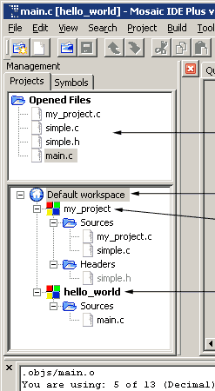
IDE features - Project management
IDEs typically include robust project management capabilities:
Organizing files and resources into projects
Managing dependencies and libraries
Configuring build settings
Integration with version control systems like Git
This centralized approach helps keep large codebases organized and makes collaboration between multiple developers more efficient.

Slide 10
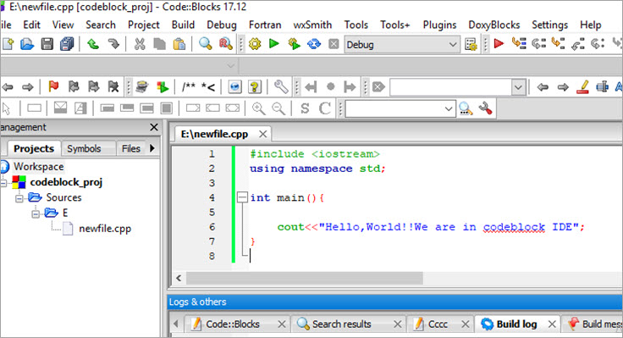
IDE features - code editing
IDEs facilitate the writing of code with features like syntax highlighting and autocomplete.
Keywords (Syntax highlighting) are normally highlighted with different colours making coding easier to code, read and understand by visually clarifying different elements of language syntax. This allows the programmer to see errors.
It has Autocompletion which reduces typing errors.

Slide 11
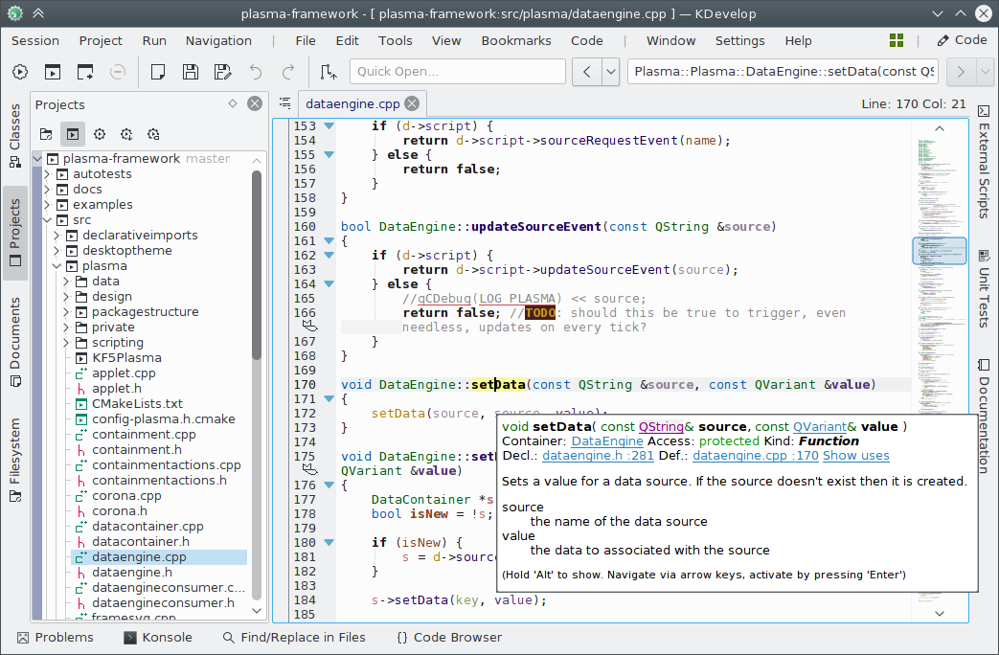
IDE features - Build automation
Many programming languages require compilation before programs can run. For example, C and C++are compiled language. Before programs run, the source code of a .cc must be transformed into an executable by the compiler. Once compiled, the program can be run from the terminal.
IDEs provide automated build processes for languages, so the act of compiling and executing code is abstracted away

Slide 12
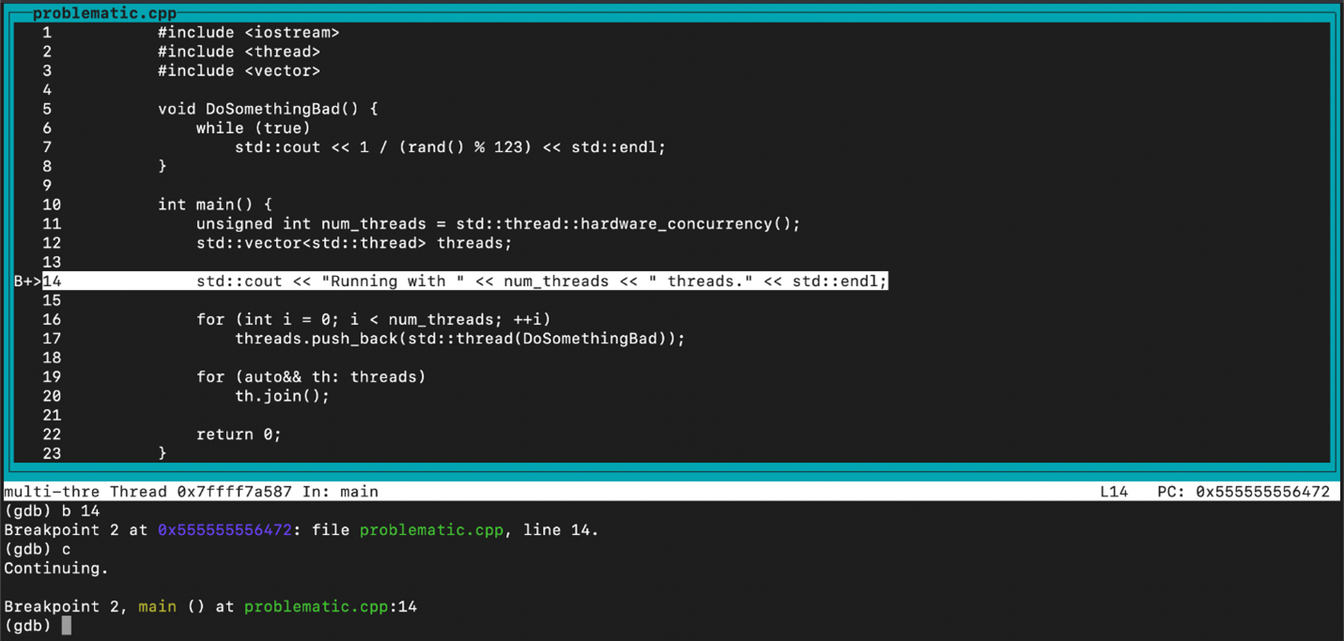
IDE features - debugging
No programmer avoids writing bugs and programs with errors. When a program does not run correctly, IDEs provide debugging tools that allow programmers to examine different variables and inspect their code in a deliberate way.
IDEs also provide hints while coding to prevent errors before compilation.

Slide 13
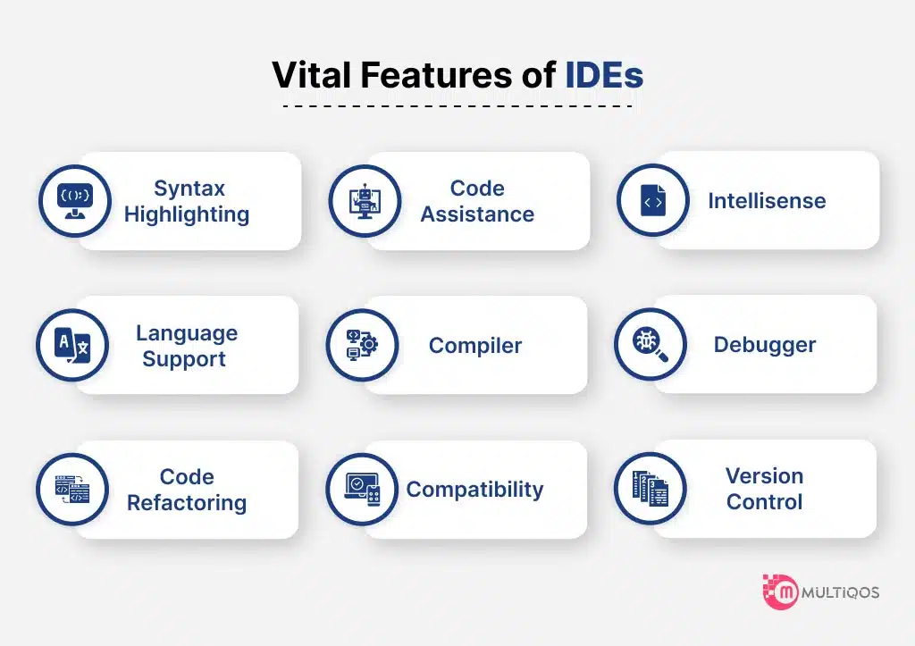
IDE features - Advanced debugging features
Setting breakpoints to pause execution at specific points
Stepping through code line by line
Inspecting variable values in real-time
Monitoring memory usage and performance
Viewing the call stack to understand program flow
These tools are invaluable for troubleshooting complex issues that would be difficult to identify through simple trial and error.

Slide 14

IDE - benefits
Increased productivity
Integrated tools mean less context switching between applications
Automation of repetitive tasks saves time
Code generation for common patterns reduces typing
Built-in documentation and quick references
Improved code quality
Real-time error detection catches issues early
Refactoring tools make code improvements easier
Consistent formatting enforces style guidelines
Code analysis suggests optimizations
Easier learning curve
Contextual help and documentation
Templates for common structures
Visual indicators for syntax and semantics
Guided workflow for beginners
Team collaboration
Integration with version control systems
Consistent development environment across the team
Shared project configurations
Code review tools

Slide 15
Exam question

Slide 16
Assessment
Now complete the online test: Purpose and functions of software used in computer systems
Lesson feedback
Now complete the lesson feedback form
Homework
Retake the online quiz.
Prepare for the next lesson
Flipping the classroom
Open and preview the following PowerPoint
7-2-4 Understand the features and use of common application software

