Slide 1

Content area 7: Digital environments
T Level Technical Qualification in Digital Production, Design and Development: 7-2-4 Understand the features and use of common application software
V3.1-1-060625
Presentation by Derek Condon MSc, MBCS, MIET

Slide 2



Starter
To get you in the mood

Slide 3
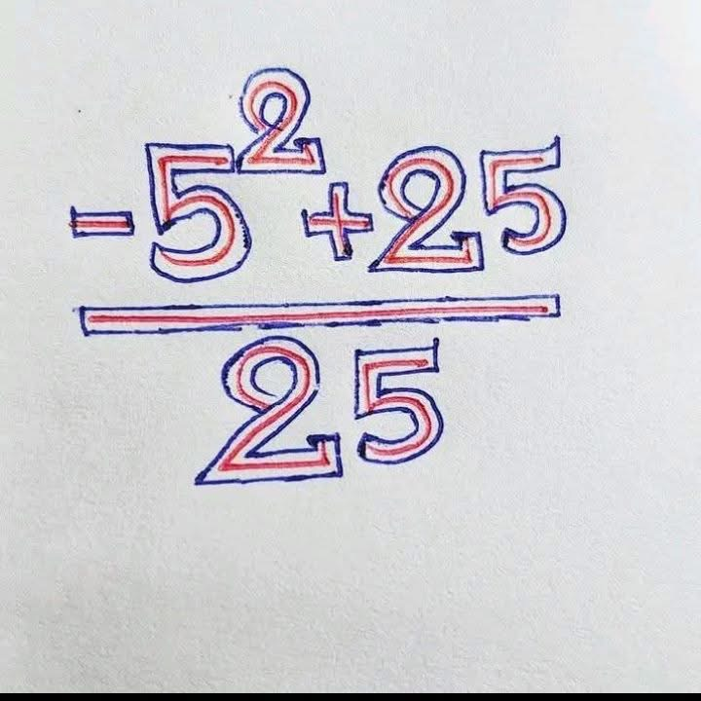
mathematics

Slide 4

Tasks:
Network
Practical’s: Packet Tracer
Assessment: Online
In this lesson you will be doing the following tasks, Practical's and Assessment

Slide 5

Aim
To understand the features and use of common application software

Slide 6
• word processors
• spreadsheets
• databases
• email
• project management software

Slide 7
For 7.2.4 students will need to understand the features and uses of common application software. They will need to know that word processors are used for creating and editing text documents, spreadsheets organise and analyse numerical data, databases store and manage structured data, email applications support communication, and project management software helps plan, track, and manage tasks and resources. Students will need to be able to explain the purpose of each type of application software and identify which one is needed in a given situation. given situation.

Slide 8

Application software

Slide 9
For 7.2.4 students will need to understand the features and uses of common application software. They will need to know that word processors are used for creating and editing text documents, spreadsheets organise and analyse numerical data, databases store and manage structured data, email
applications support communication, and project management software helps plan, track, and manage tasks and resources. Students will need to be able to explain the purpose of each type of application software and identify which one is needed in a given situation.

Slide 10
Application Software
Communication Software: | includes email, instant messaging, social media and video conferencing. For example: ‘Snapchat’ & ‘Outlook’
Computer Aided Design: (CAD) | software used to produce highly detailed technical drawings such as building plans or when designing a car’s engine. For example: ‘AutoCAD’
Database Management Systems: | used to create and manage complex, relational databases.
Digital Graphics and Animation: | the art of creating of moving images by the use of the computers. For example ‘Adobe Photoshop’ & ‘Blender’
Enterprise Resource Packages: (ERP) | an integrated software package used in industry to share data between all areas of a business including managing orders, stock, payroll and company finances
Entertainment Software: | a group of software programs that include, media players and games.
Office Software: | PowerPoint, Word, Spreadsheet etc
a program or a group of programs designed for end users, which are people who actually uses a particular product.

Slide 11
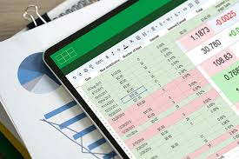
Spreadsheets: features
For:
A range of built-in formulas and functions to allow detailed and complex analysis
Would be good for analysing energy data, showing trends etc.
Can easily generate graphs etc. to visualise data
Ease of use – typically easier for less experienced users than DBMS software
Availability – spreadsheets are usually packaged with most office suites whereas DBMS is often an additional extra.
Against:
Data redundancy – storing data in a spreadsheet can lead to greater replication of data, which may cause errors, compared to a database that can create related data tables and enforce integrity
Not recommended for personal data (formatting, security etc.)
Searching and sorting become less efficient the larger the data set gets, compared to a database where data will be more compartmentalised.
Often less secure than a DBMS which can provide more granular control over access to specific parts of the data

Slide 12
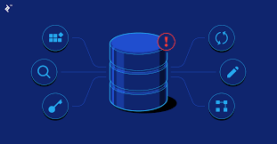
Databases : features
Used to:
to link bookings with customer records, patient and staff files etc.
Queries/search features
Report outputs
Can create relationships
Key fields / unique records / Reduced data redundancy
Calculations/calculated fields
Sorting / filtering
Visualisation tools (e.g. graphs, dashboards)
Centralised data / data accessible to multiple users
Security features (e.g. encryption, user access permissions)
Data validation / data type enforcement

Slide 13
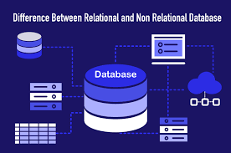
Relational Database: features
data redundancy will be reduced
which increases accuracy/reliability of data
data can be normalised
data can be split (into separate tables)
changes to data are applied to linked tables
data can be related to / associated with other data in different ways
allows more complex/customised searches
data can be searched/found more easily
results can show associated information
can be output using reports / customised output formats

Slide 14
Application Software to support businessses
TASK | SOFTWARE
Staff / patients details etc | Relational database software
organise staff and schedules | Spreadsheets or project management
access bookings | Shared/online calendar
Producing communications and other materials | Office productivity software (word processing, DTP etc)
Communicating with customers and suppliers etc | Email software
Organise salaries and payrolls | Spreadsheets
Perform calculations show trends monitor/predict performance | Spreadsheets

Slide 15
Factors affecting the choice, use and performance of Hardware, Utility Software & Application Software
Security | The state of being free from danger or threat
Performance | The action or process of performing a task or function
Efficiency and Effectiveness | The degree to which something is successful in producing a desired result
Compatibility | A state in which two things are able to exist or occur together without problems or conflict
Productivity | The measures of the efficiency of production
Requirements & User Needs | Does it fit within the guidelines of the user’s desires?

Slide 16
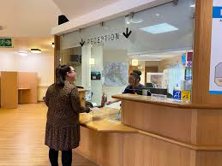
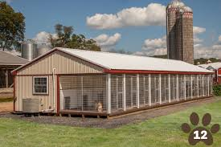
Software to support work Consider a doctor's surgery or dog kennels. what application software will be used?

Slide 17
Software to support work Consider a doctor's surgery or dog kennels. what application software will be used?(Doctors surgery)
Relational database software – patient and staff files etc
Spreadsheets or project management software to organise
staff and schedules
Calendar software and communication software (e.g. Teams)
Office productivity software (word processing, DTP etc) for
Producing communications and other materials for patients
Email software
Schedule and manage patient appointments
Organise work schedules for the office staff, clearers and GPs
Organise salaries and payrolls
Communicate with patients, pharmacies and hospitals about medical issues
Financial transactions (payroll etc)
Database to link bookings with customer records
Spreadsheet to calculate the number of staff needed each day
Shared/online calendar to be able to access bookings on any device / share bookings with staff
Factors
Security and privacy of sensitive, personal medical data.
Avoiding data redundancy

Slide 18
Factors affecting the choice, use and performance of Hardware, Utility Software & Application Software
Implementation Timescales & Testing Migration | How long it will take to implement based on the time frame given to have it operating and ready to use. Plus, how long will it take to test?
Cost & Budget | How expensive will it be and will it fit within the individual’s budget?
Ease of Use & User Experience | It is easy to use? Intuitive? Does it make a positive user experience?

Slide 19
Assessment
Now complete the online test: Purpose and functions of software used in computer systems
Lesson feedback
Now complete the lesson feedback form
Homework
Retake the online quiz.
Prepare for the next lesson
Flipping the classroom
Open and preview the following PowerPoint
7-3-1 Understand the benefits and drawbacks of connecting devices to form networks

