Slide 1

Content area 7: Digital environments
T Level Technical Qualification in Digital Production, Design and Development: 7-3-1 Understand the benefits and drawbacks of connecting devices to form networks
V3.1-1-060625
Presentation by Derek Condon MSc, MBCS, MIET

Slide 2
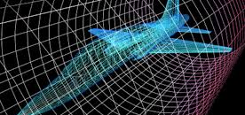
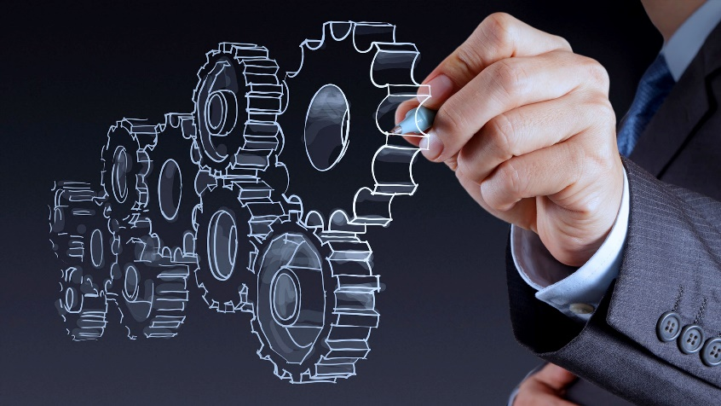
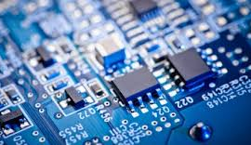
Starter
To get you in the mood

Slide 3

Problem solving

Slide 4

Joke of the day

Slide 5

mathematics

Slide 6

In this lesson
Tasks: x
Lesson feedback
Practical:
Packet Tracer
Assessment:
Online
Maths:
Geometry
English:
Reading
Soft Skills:
Presentation (some)
Problem solving
E&D: All material available for non attendees

Slide 7
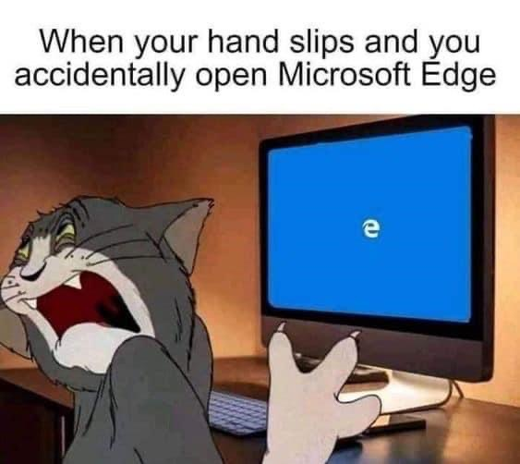
Is this you??

Slide 8

Aim
7-3-1 Understand the benefits and drawbacks of connecting devices to form networks

Slide 9
For 7.3.1
Students will need to:
understand the benefits and drawbacks of connecting devices to form networks.
know that networks allow resource sharing, communication, and collaboration, and can improve efficiency and data access.
understand the drawbacks, including security risks, costs of setup and maintenance, and potential network failures.

Slide 10
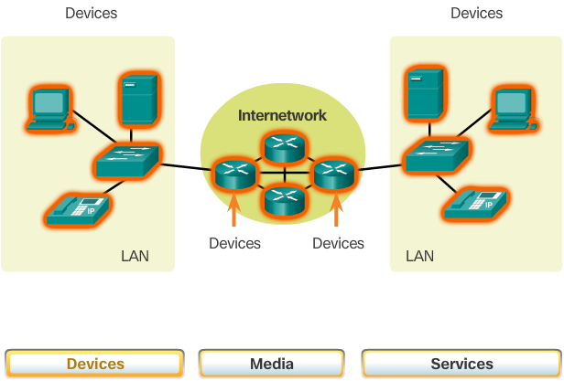
Overview of Network Components
Notes:
1.2.1.1 Overview of Network Components

Slide 11
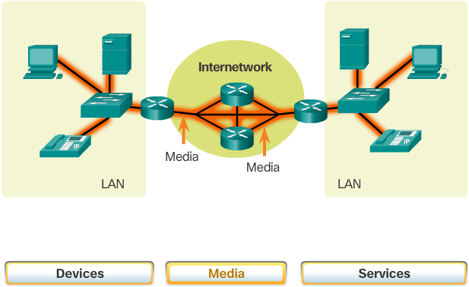
Overview of Network Components (cont.)
Notes:
1.2.1.1 Overview of Network Components (Cont.)

Slide 12
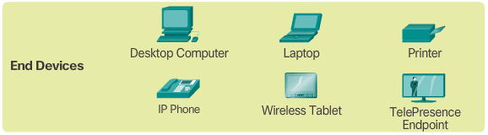
End Devices
Notes:
1.2.1.2 End Devices

Slide 13
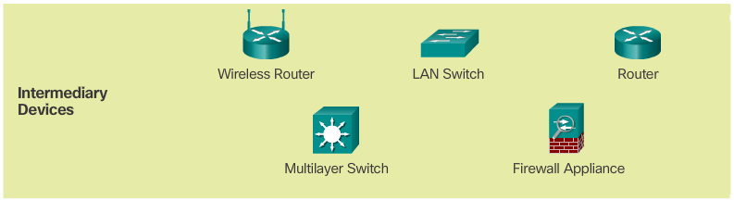
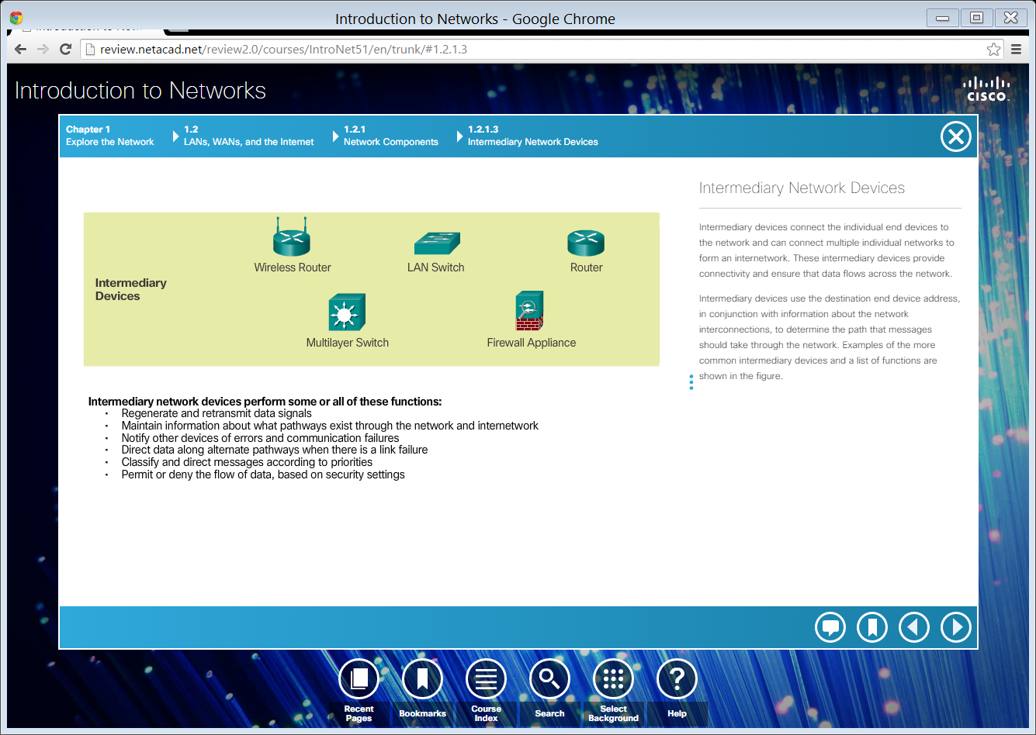
Intermediary Network Devices
Notes:
1.2.1.3 Intermediary Network Devices

Slide 14
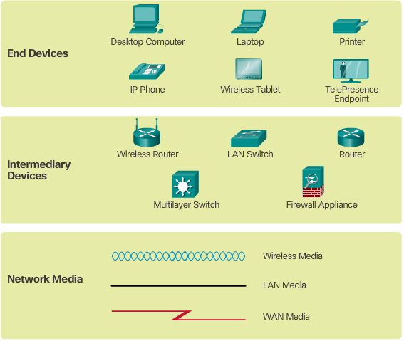
Network Representations
Notes:
1.2.1.5 Network Representations

Slide 15
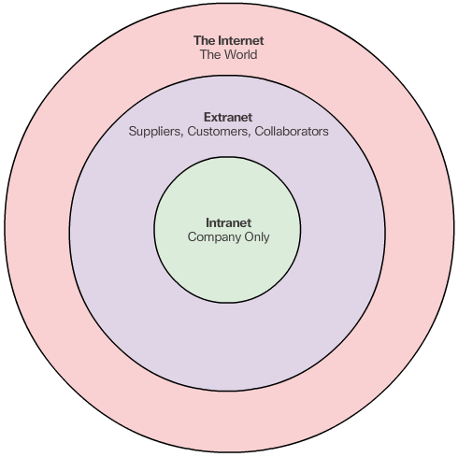
Intranets and Extranets
Notes:
1.2.3.2 Intranets and Extranets

Slide 16
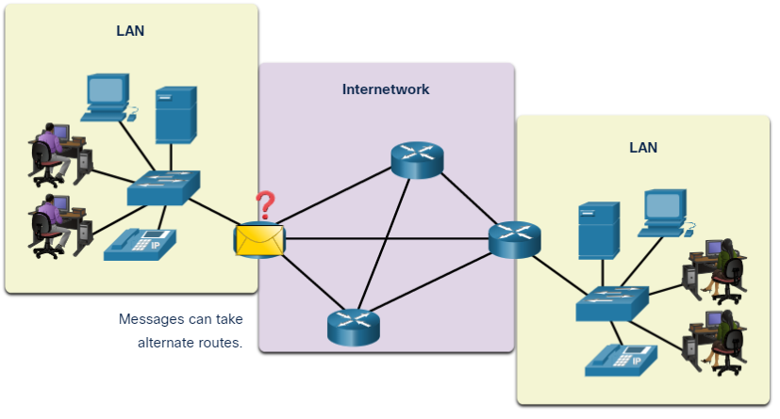
Network Components
End Devices
  An end device is where a message originates from or where it is received.
  Data originates with an end device, flows through the network, and arrives at an end device.
They are the interface between humans and the communication network
Notes:
1 – Networking Today
1.2 – Network Components
1.2.3 – End Devices

Slide 17

Task 1: How many end devices can you name?

Slide 18
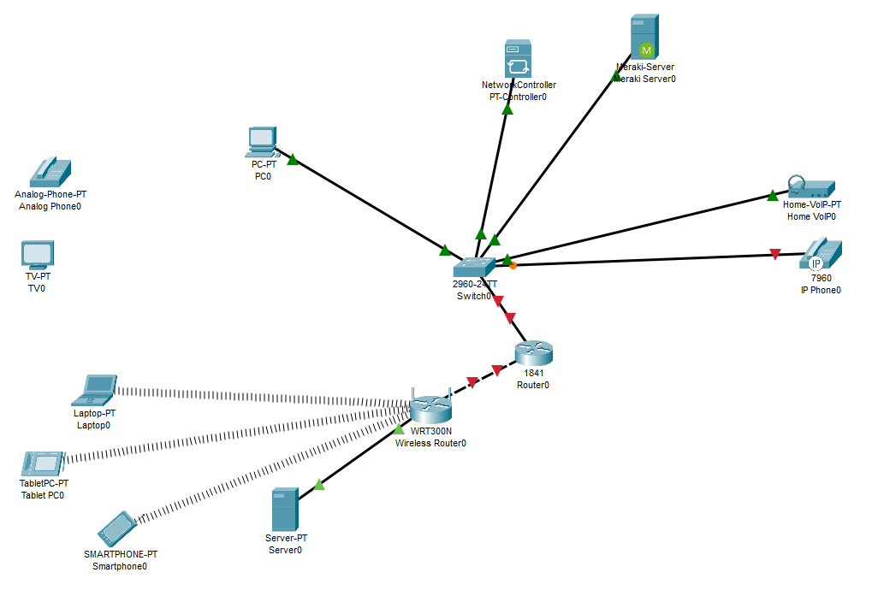

How many end devices can you name?
PC
Laptop
Server
Network Controller
Printer
IP Phone
VOIP Device
Phone
TV
Tablet
Smart Phone

Slide 19
benefits of connecting devices to form networks
Resource Sharing:
  Devices can share
  printers
    Storage
    Software
    Internet connections
Centralised Data Access:
Users can access files and databases from any connected device, improving collaboration and productivity.
Improved Communication: Email, messaging, video conferencing, and VoIP services are enabled across the network.
Scalability: Networks can grow by adding more devices without major infrastructure changes.
Remote Access: Users can connect to the network from different locations, enabling remote work and support.
Data Backup and Recovery: Centralised systems allow for easier implementation of backup and disaster recovery strategies.
Security Controls: Permissions and access levels can be managed centrally to protect sensitive data.
Sharing, communication, and collaboration, and can improve efficiency and data access
Reducing costs
Improved efficiencies.

Slide 20
drawbacks of connecting devices to form networks
Security Risks:
Networks are vulnerable to:
hacking
malware
unauthorized access if not properly secured.
Maintenance Complexity:
Requires skilled personnel to manage hardware, software updates, and troubleshoot issues.
Initial Setup Costs:
Infrastructure like routers, switches, and cabling can be expensive to install.
Downtime Impact:
If a central server or key component fails, it can disrupt the entire network.
Data Privacy Concerns:
Shared environments may expose sensitive information if access controls are weak.

Slide 21
Video

Slide 22
devices connected to form networks
Practical 1

Slide 23

Assessment
Now complete the online test: connecting devices to form networks
Lesson feedback: Now complete the lesson feedback form. Lesson feedback form
Comment on what could be added to make the lesson better
Homework: Retake the online quiz.
Prepare for the next lesson
Flipping the classroom
Open and preview the following PowerPoint in preparation for the next lesson.
7-3-2 Understand the features, characteristics, benefits and drawbacks of wireless connection methods

